Slide 1

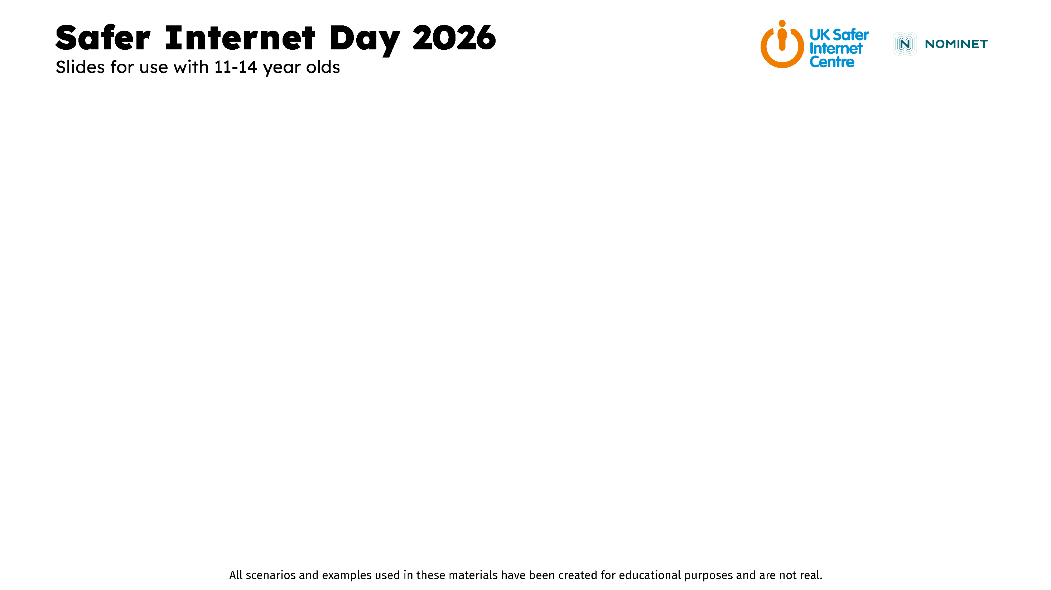

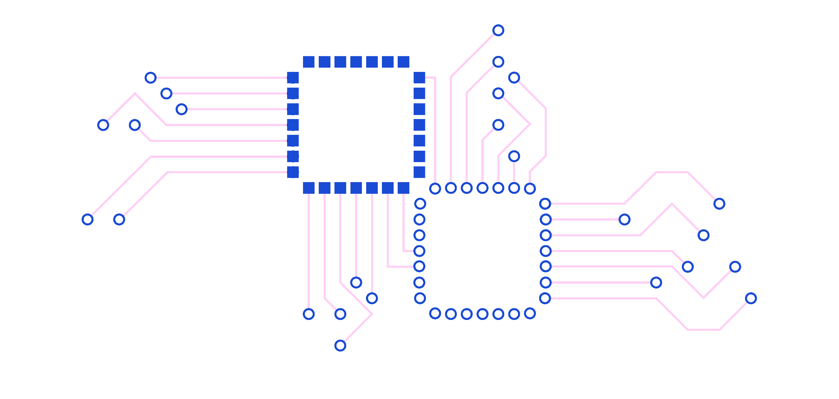

Slide 2

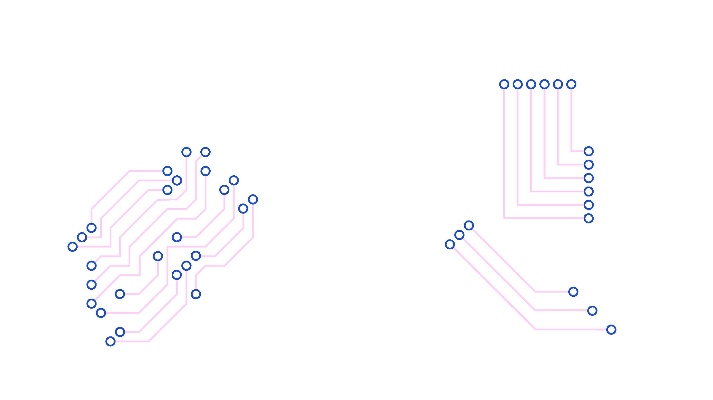
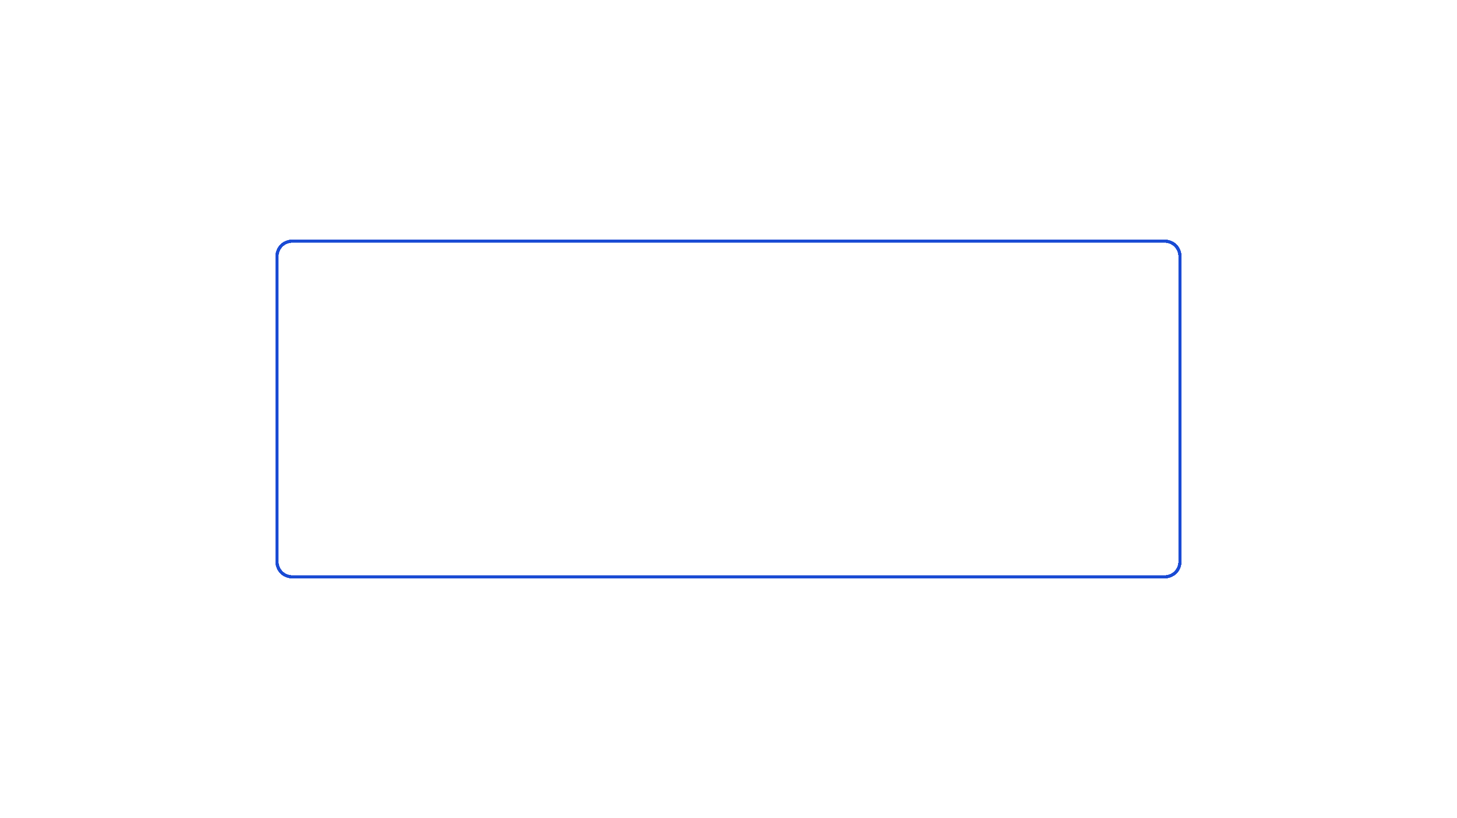
AI and harmful behaviours

Slide 3

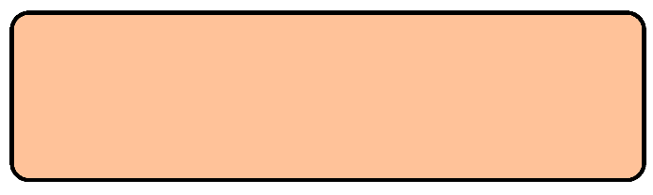
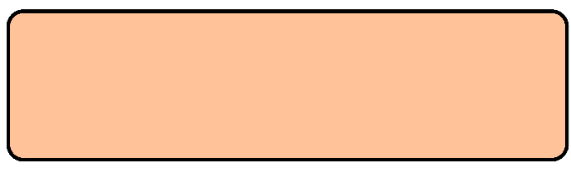


‘Creating an AI image of somebody else isn’t a big deal because it’s not real’
AGREE
DISAGREE

Slide 4

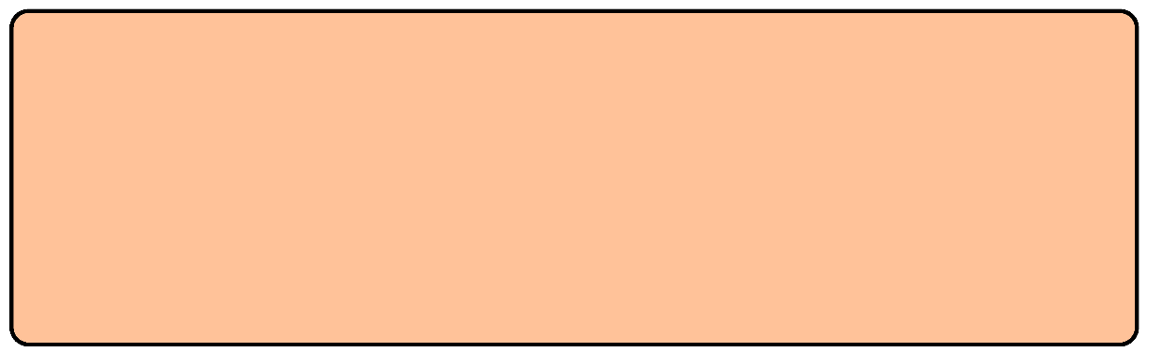
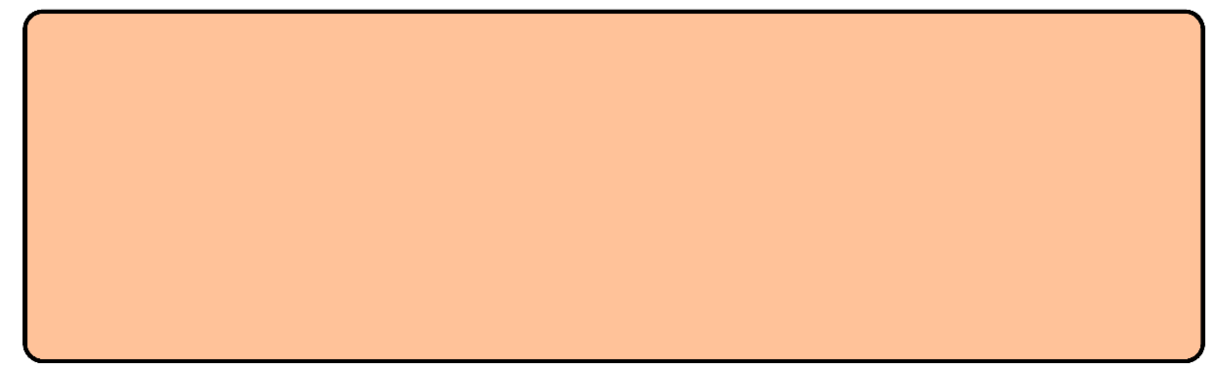
Scenario 1
Megan dreams of becoming a makeup artist, and posts pictures of her own makeup on social media to build her audience and portfolio.
One day, a picture of Megan is posted in a group chat. The image was screenshotted from her profile and had been edited using AI to change her appearance. Other members of the chat were making fun of her.
The picture made Megan feel insecure about herself.
How might this situation impact Megan now and in the future?
What should Megan do next?

Slide 5
Scenario 2
Jon receives a new follower request. He finds them very attractive, and they have some mutual friends, so he decides to accept it.
Jon messages his new follower, and the pair chat back and forth for weeks. They talk about their personal lives and problems, and Jon feels he can trust them. They agree to meet up the next day.
When Jon arrives at their meeting point in the local town centre, he is greeted by a group of young people from school. They had created a fake profile and pictures using AI to catfish Jon and to trick him.
How might this situation impact Jon now and in the future?
What should Jon do next?

Slide 6
Scenario 3
Ria receives a new message from an unknown number, the message is harmless, so she decides to ignore it.
As the next hour goes by, Ria receives an influx of messages from the unknown number. The messages get increasingly more offensive, and they become very upsetting. Ria tells them to stop, but this makes the messages even worse.
Ria discovers that somebody had used AI to write and send these
messages quickly.
How might this situation impact Ria now and in the future?
What should Ria do next?

Slide 7
Scenario 4
While scrolling through a video sharing platform, Mat comes across a video of himself. The video is inappropriate, and contains AI generated footage of Mat doing something he has never done.
The video gradually gains more views overnight, with lots of people sharing it and commenting. He also receives lots of nasty messages about the video from people at school.
He feels embarrassed and alone, as he feels he will get in trouble if he says anything to his parents.
How might this situation impact Mat now and in the future?
What should Mat do next?

Slide 8
Scenario 5
Gio posts a picture on his social media of himself on holiday, he feels happy with the photo and likes how he looks.
In the morning, Gio wakes up to find he has received 50 comments on his photo. At first, he feels excited that his photo has got lots of engagement but soon finds out that the comments are all making negative remarks about his appearance.
The comments come from users with strange usernames and are not people he recognises.
How might this situation impact Gio now and in the future?
What should Gio do next?

Slide 9
Scenario 6
Billie enjoys playing video games.
One day, she tries to play her favourite video game and discovers that her account has been banned due to reports of unacceptable behaviour. Billie feels confused, as she has never done any of the things she has been accused of.
Billie’s friend tells her that people can use AI to create false reports and make them seem as though they are coming from different users.
How might this situation impact Billie now and in the future?
What should Billie do next?

Slide 10

‘Bullying using AI is less harmful than other forms of bullying’
AGREE
DISAGREE

Slide 11

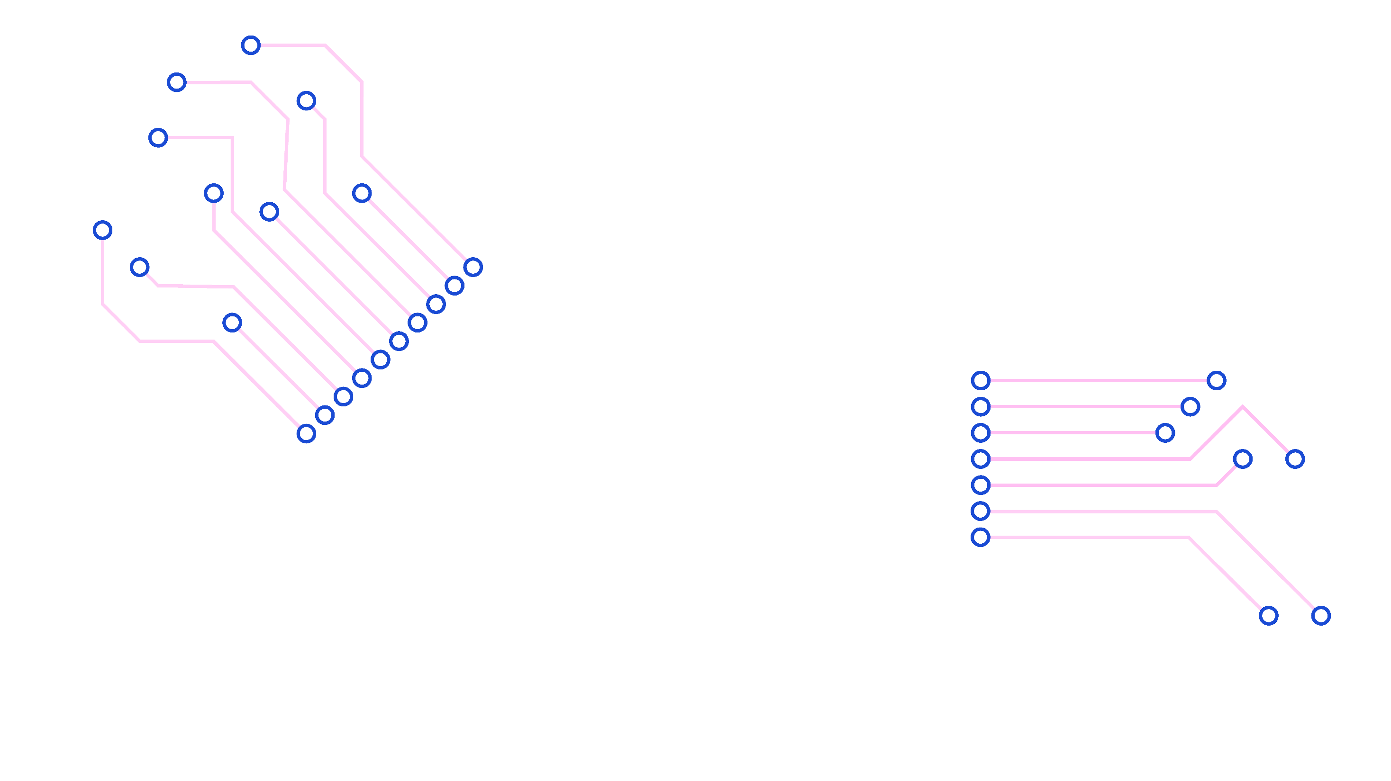

Ethics and AI

Slide 12

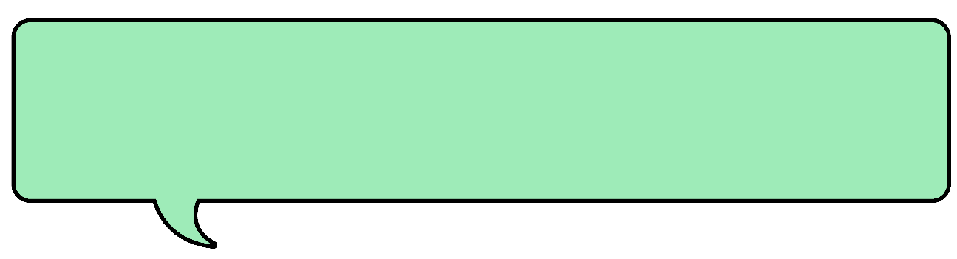
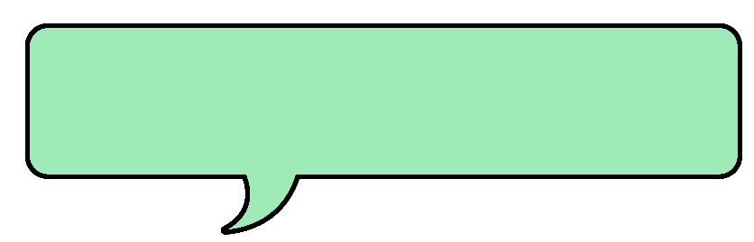
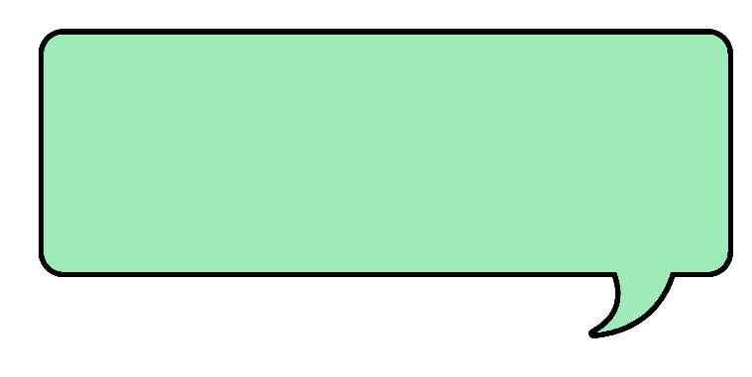
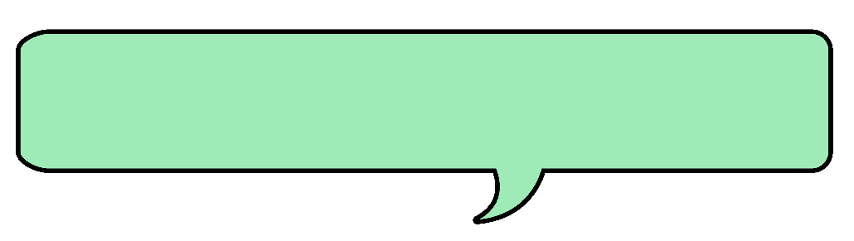

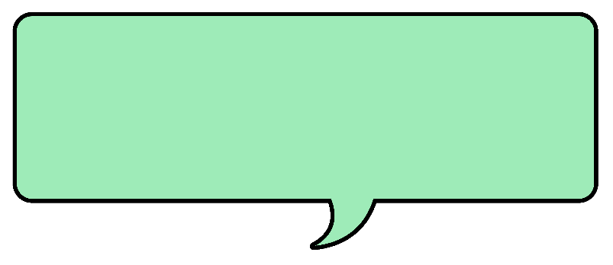
I only use AI if I have to because of its environmental impact.
AI tools are biased.
AI makes people less creative.
AI relies on stolen work.
I am careful with what information I share with AI models.
AI allows me to be more productive.

Slide 13

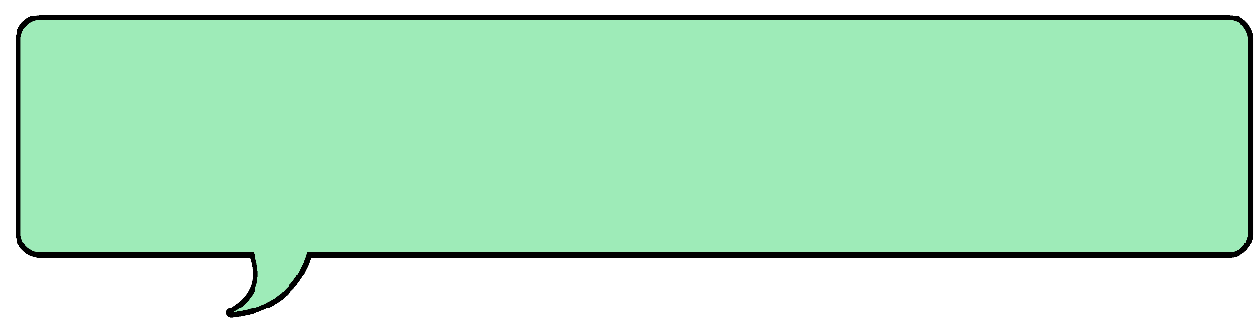
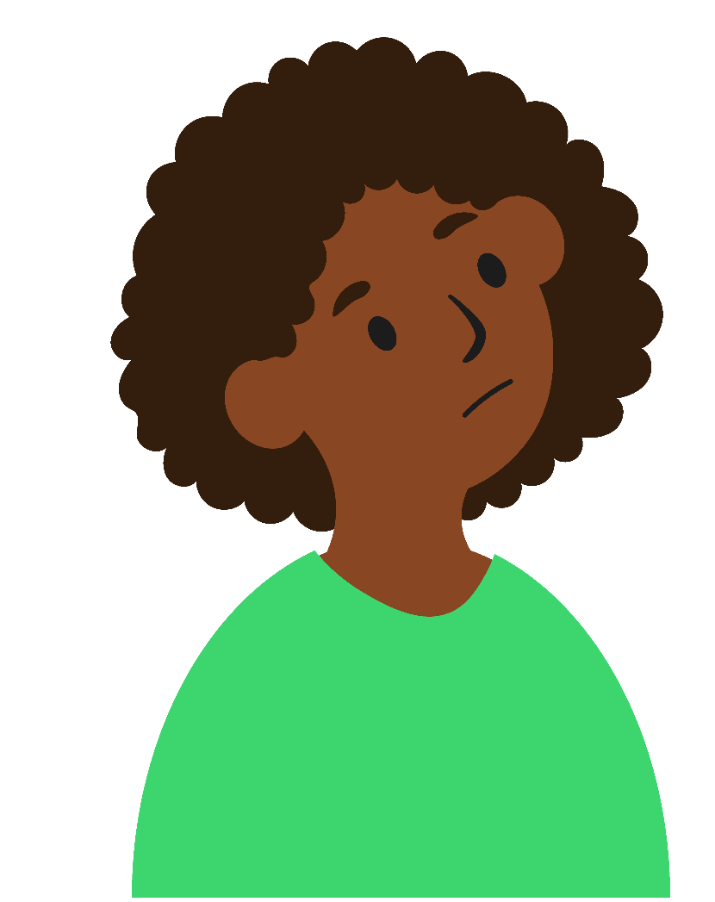
I only use AI if I have to because of its environmental impact.
Zuri tries to reduce her environmental impact where she can. She already makes choices like using public transport and buying things second hand. Sometimes Zuri’s job means that she has to use AI, but she chooses not to in her personal life because she is concerned about the amount of resources used by AI models.
Training and deploying an AI model requires lots of electricity, which leads to increased carbon dioxide emissions unless using renewable sources. Also, water is needed to cool the hardware used for AI technologies, particularly the large data centres they need to train and be deployed. Training and using AI technologies uses more power than typical computing so for people like Zuri, it uses more natural resources than they are comfortable with.

Slide 14
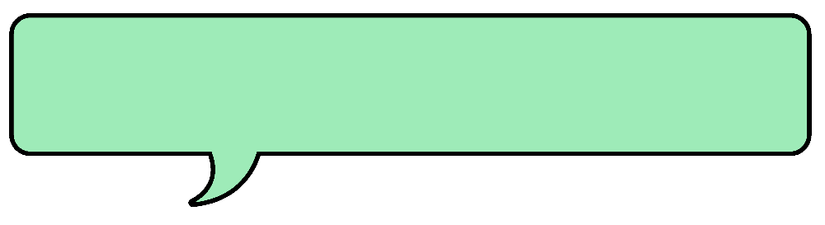
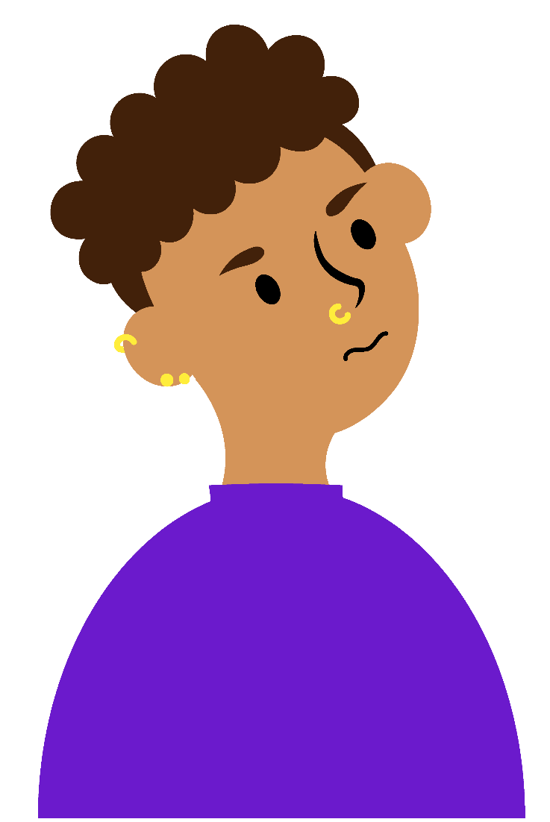
AI relies on stolen work.
Luka is an artist and has a distinctive art style. He saw someone posting art that looked very similar to his, which at first he didn’t think anything of. After this started to happen more, he looked into it and realised that many generative AI models are trained using artists’ work without their permission. Luka is concerned people won’t buy his work if they can make something similar themselves.
It is not just artists who have complained about this. Musicians, writers and coders have also publicly claimed that their work has been used to train AI models. Some argue that generative AI wouldn’t be possible without this training data. Some people may see it as okay that art inspires more art. The creators of the models say it would be difficult to get permission.

Slide 15
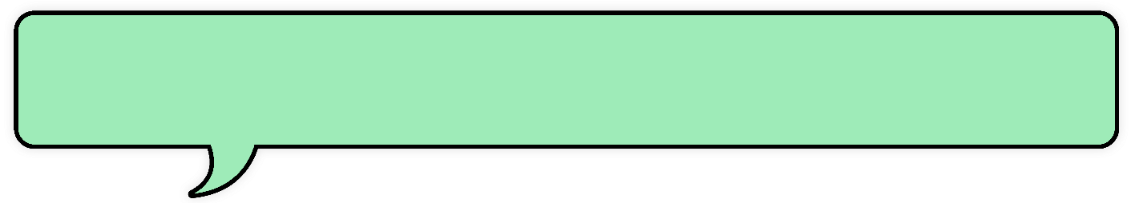
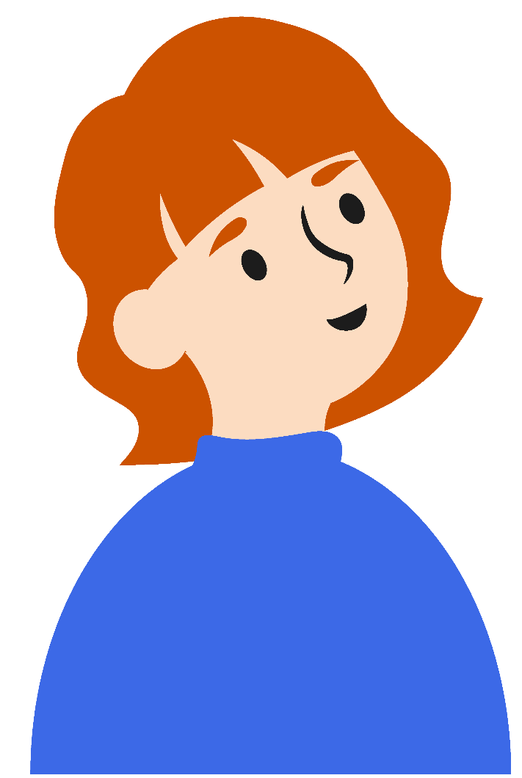
AI allows me to be more productive.
Sofia is part of a small charity. A lot of her time can be taken up writing emails, blogs and social media posts, but this isn’t the main part of her job. When she uses AI, it saves her time and means she can get to the parts that she wants to focus on. It also saves her charity money as they don’t have to pay another person to
help her.
Many organisations are using AI more to help with productivity. Some studies on jobs like coders, call-centre workers and even taxi drivers have found that tasks can be performed faster when using AI. However, this has not been thoroughly studied. Some people may also be concerned about the impact this will have on employment, and that some people may lose their
jobs to AI.

Slide 16

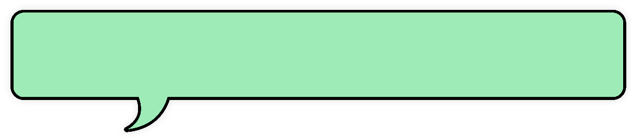
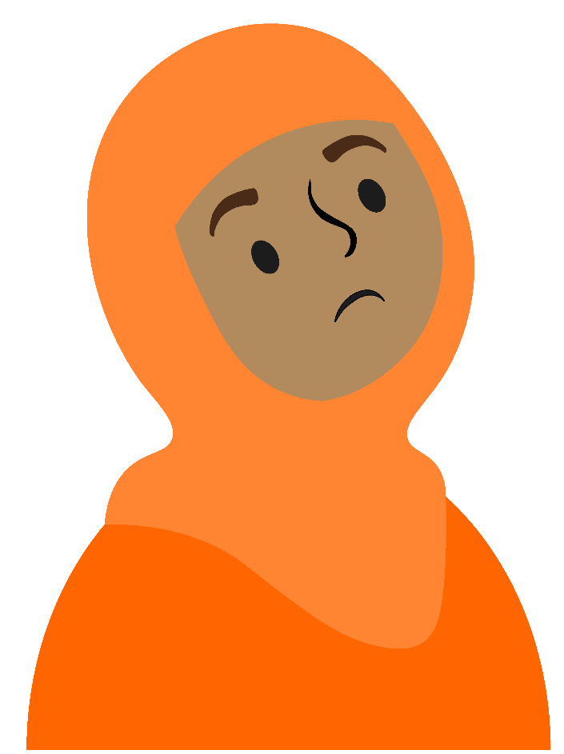
AI makes people less creative.
Eshani started using AI quite a lot when she first heard about it. She enjoys writing stories and poems and would use AI to give her ideas, or help when she was stuck. Over time, Eshani found herself turning to AI more and more, as it was quicker and easier. After a while, she realised that she was always using AI when she was writing so she decided to stop and use her own ideas more.
Many people find AI to be a tool that helps them to complete tasks and give them inspiration. However, some researchers suggest that over reliance of AI can decrease the diversity of ideas people have and may have long-term impacts on how people think.

Slide 17
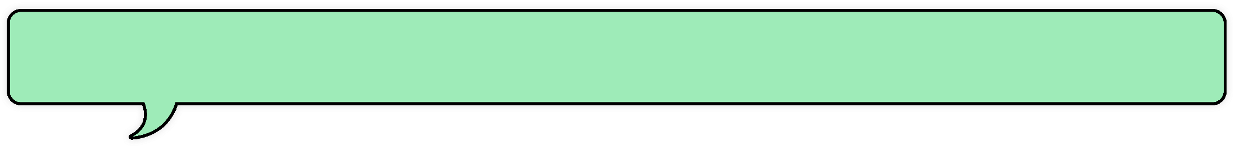
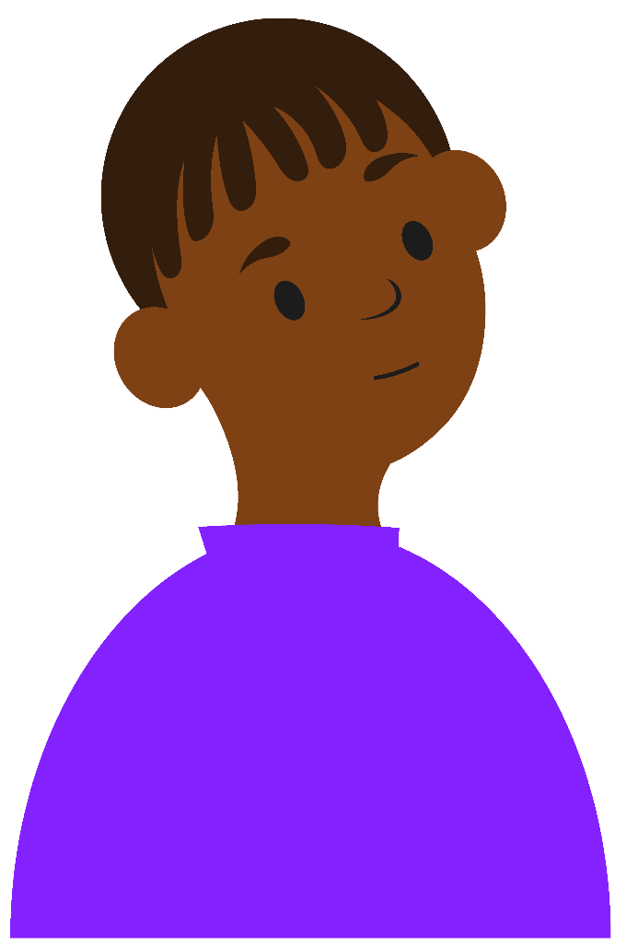
I am careful with what information I share with AI models.
André finds AI tools useful to help him complete tasks and answer questions. When he was using it one day, he realised that it was referring to something he shared on a previous day. He thought that if it had stored this information, it could be storing other details about him. After that, he decided to only share information that he would be comfortable sharing publicly.
Many AI platforms use data they’ve collected to train and refine their AI models. However, many people may not consider how their data is being used when they start using the platform. For some models, you might be able to find out more about this in their terms and conditions, but for others it can be more difficult. It may also be that an app you already use decides to add AI functionality, and users may not realise their data is now being used to train this. Sometimes, you may also be able to adjust your settings around how AI uses your data.

Slide 18
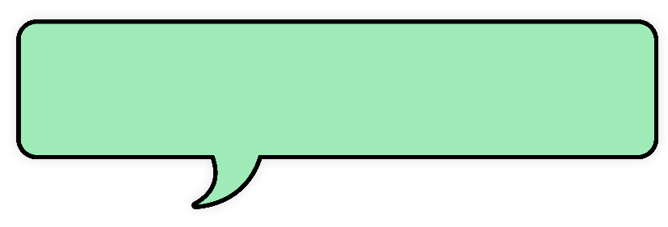
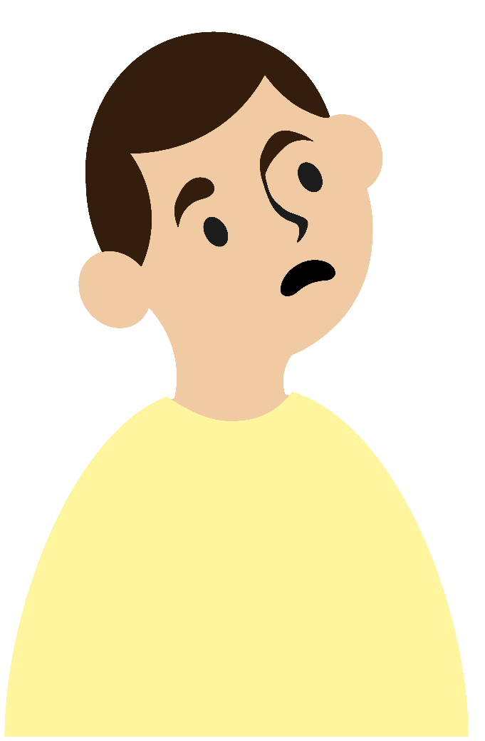
AI tools are biased.
Narek likes to create images using AI. He has noticed when he creates images, it often chooses aspects of the picture based on stereotypes. Like when he wanted to create an image of a doctor, it assumed that he wanted it to be male. Narek now makes his prompts very specific to try and make sure he isn’t continuing any biases.
If an AI model is trained on biased data, it can take on human biases and then amplify these. People interacting with these could then become more biased themselves.

Slide 19
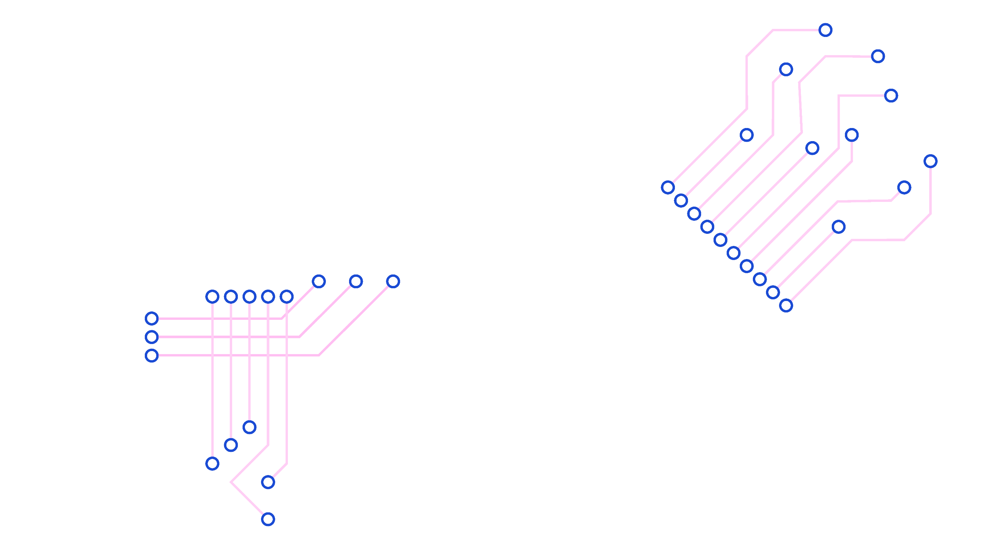

Reduced text slides

Slide 20
I only use AI if I have to because of its environmental impact.
AI relies on stolen work.
AI allows me to be more productive.
AI makes people less creative.
I am careful with what information I share with AI models.
AI tools are biased.

Slide 21
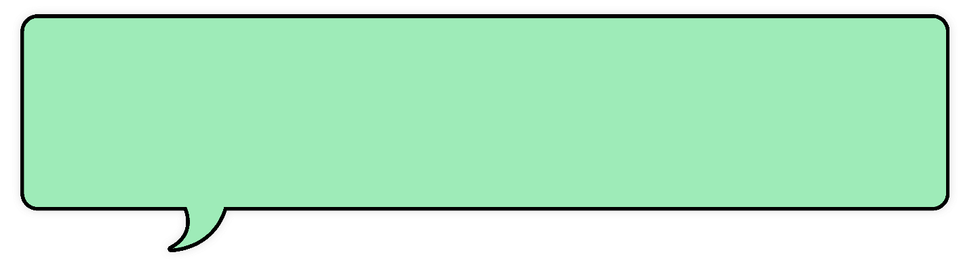
I only use AI if I have to because of its environmental impact.
AI uses a lot of electricity which can
cause increased carbon dioxide in the atmosphere. Also, water is needed to cool
the hardware used.
Training and using AI uses more power than typical computing so some people may decide not to use it.

Slide 22
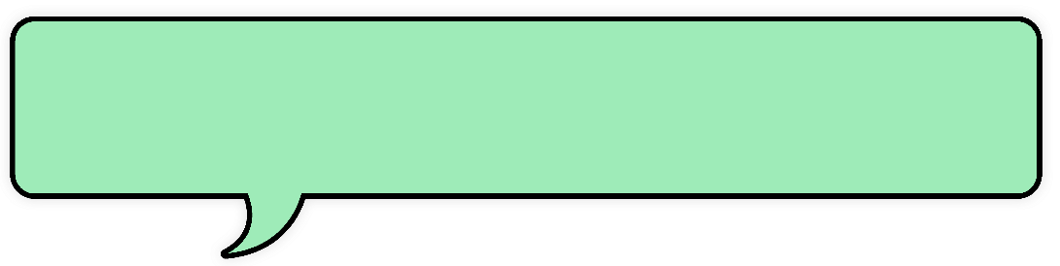
AI relies on stolen work.
AI is trained on data, including art, music and writing. Many artists, musicians, writers and coders have had their work used for this without their permission.
Some people are upset they didn’t get a choice whether their work would be used, or that they didn’t get any money for their work.

Slide 23
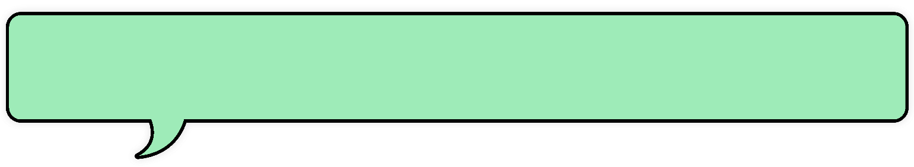
AI allows me to be more productive.
AI can save time by helping people complete tasks more quickly.
However, some people may be concerned that some people may lose their jobs if using AI can replace them.

Slide 24
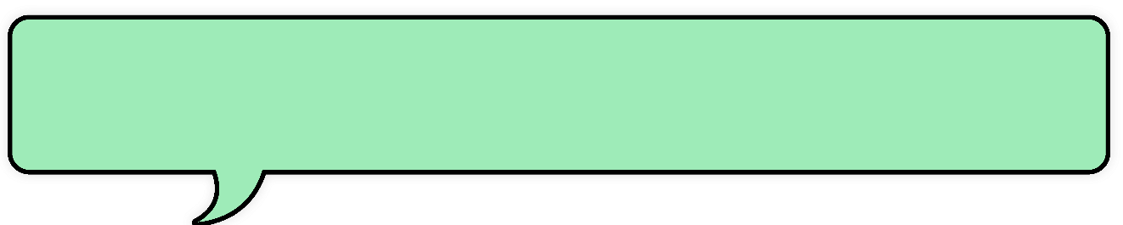
AI makes people less creative.
Many people find using AI a tool that helps them to complete tasks and give them inspiration.
However, some researchers suggest that using AI too much can affect how people think and reduce how many ideas they can think of.

Slide 25
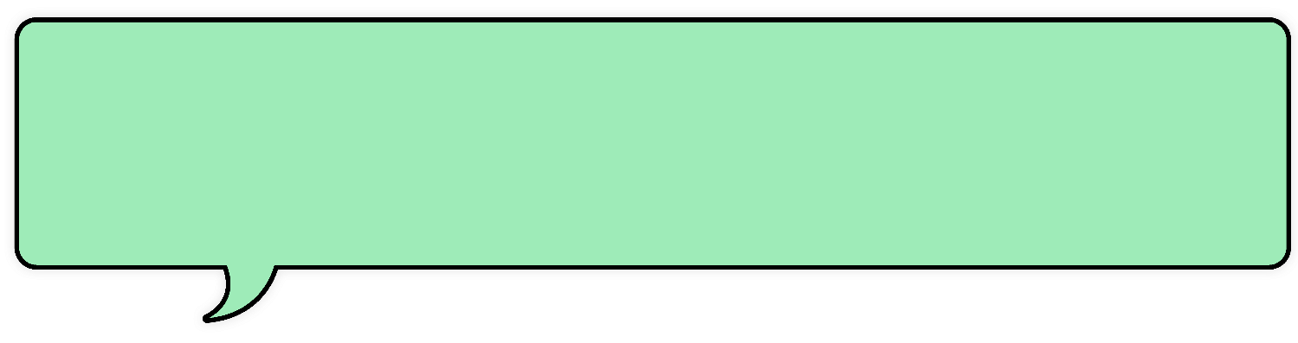
I am careful with what information I share with AI models.
Many AI platforms use information they’ve collected from users to train and improve their AI models.
However, many people may not consider how their data is being used and it is not always clear. Sometimes, you may be able to adjust your settings around how they use your data.

Slide 26
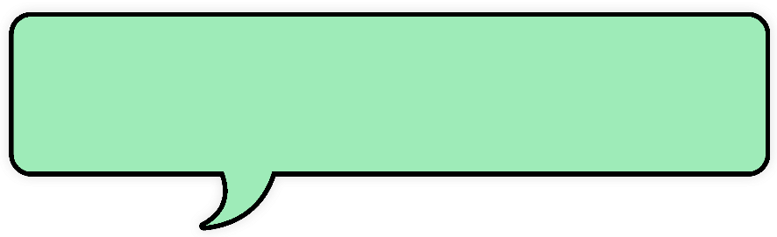
AI tools are biased.
Sometimes AI may show stereotypes, like assuming that a doctor is male.
If an AI model is trained on biased data, it can take on human biases and then continue these. People interacting with these could then become more biased themselves.

