Slide 1


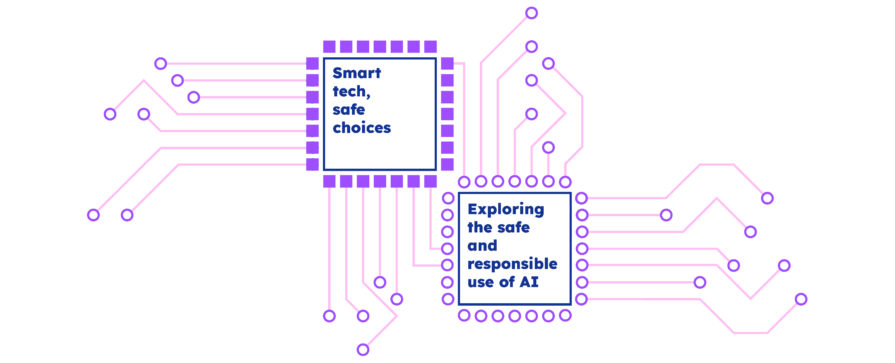

Slide 2



Roo’s new friend

Slide 3







Roo’s new friend is smart.
They can answer all her questions and tell her cool facts.

Slide 4










Roo’s new friend can play music.
Roo asks for different songs she can dance to.

Slide 5





Roo’s new friend sets an alarm for dad in the morning.
They help dad wake up.

Slide 6



Roo’s new friend sets an alarm for dad in the morning.
They help dad wake up.

Slide 7






Roo’s new friend is magical.
They can turn the lights on and off without touching the switch.

Slide 8





Roo’s new friend is magical.
They can turn the lights on and off without touching the switch.

Slide 9



Roo thinks her new friend is great, but is confused
why she can’t see what they look like. Roo asks her Dad for help.

Slide 10




“This is a voice assistant,” said Dad. “They can be lots of fun, but they are not real people.” Roo feels sad. She thought her new friend was real.

Slide 11



“Voice assistants are a type of technology,” Dad explains.“They don’t have feelings, they can’t cook dinner, and they can’t give you a hug.”

Slide 12



From that day on, Roo still loves to use her voice assistant to play songs and tell her fun facts. But she always remembers that they are not a real person.

Slide 13


The voice assistant

Slide 14







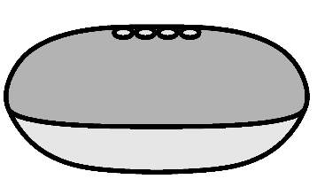
This is a voice assistant.

Slide 15





Voice assistants can tell us information.

Slide 16

Voice assistants can play music.

Slide 17




Voice assistants can set alarms.

Slide 18






Voice assistants can turn the lights on and off without touching the switch.

Slide 19
Voice assistants are not real people.
They are a type of technology.

Slide 20


Voice assistants don’t have feelings
and can’t give us hugs.

Slide 21



Understanding voice assistants
Extension

Slide 22





Voice assistants are a type of computer program and a form of technology.
They can access lots of information and can connect to other devices like lights and TVs.

Slide 23



Voice assistants respond to speech.
They are often found on phones, speakers, TVs and watches.

Slide 24


Voice assistants need to be connected to the internet to work.
Some may also need to be plugged in.

Slide 25






Voice assistants are a type of
Fill in the gaps with the correct words
They can access lots of
speech
computer program
They respond to:
information
They need to be connected to the
Alexa
internet
An example of a voice assistant is

Slide 26


How can I use a voice assistant?

Slide 27




Play my favourite song

Slide 28

Ask what the weather is like

Slide 29

Play a video I’ve been told not to watch

Slide 30

Play a video I like

Slide 31

Tell me a joke

Slide 32

Play loud music when someone is trying to sleep

Slide 33

Make a mean joke about someone I know

Slide 34

Send a message to a family member

Slide 35

Ask it a question about a bad word

Slide 36

Send an unkind message to someone

Slide 37

Set a timer to help me remember when to come off my game

Slide 38



Buy something from an online shop without asking a grown up first

Slide 39


How do voice assistants make us feel?

Slide 40








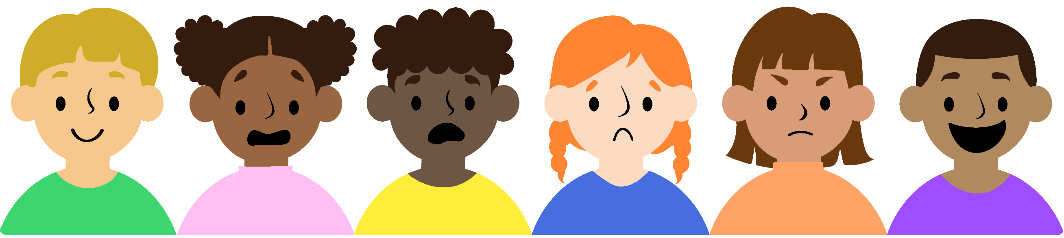
What emotions do we sometimes feel?
Happy
Worried
Annoyed
Scared
Sad
Excited

Slide 41
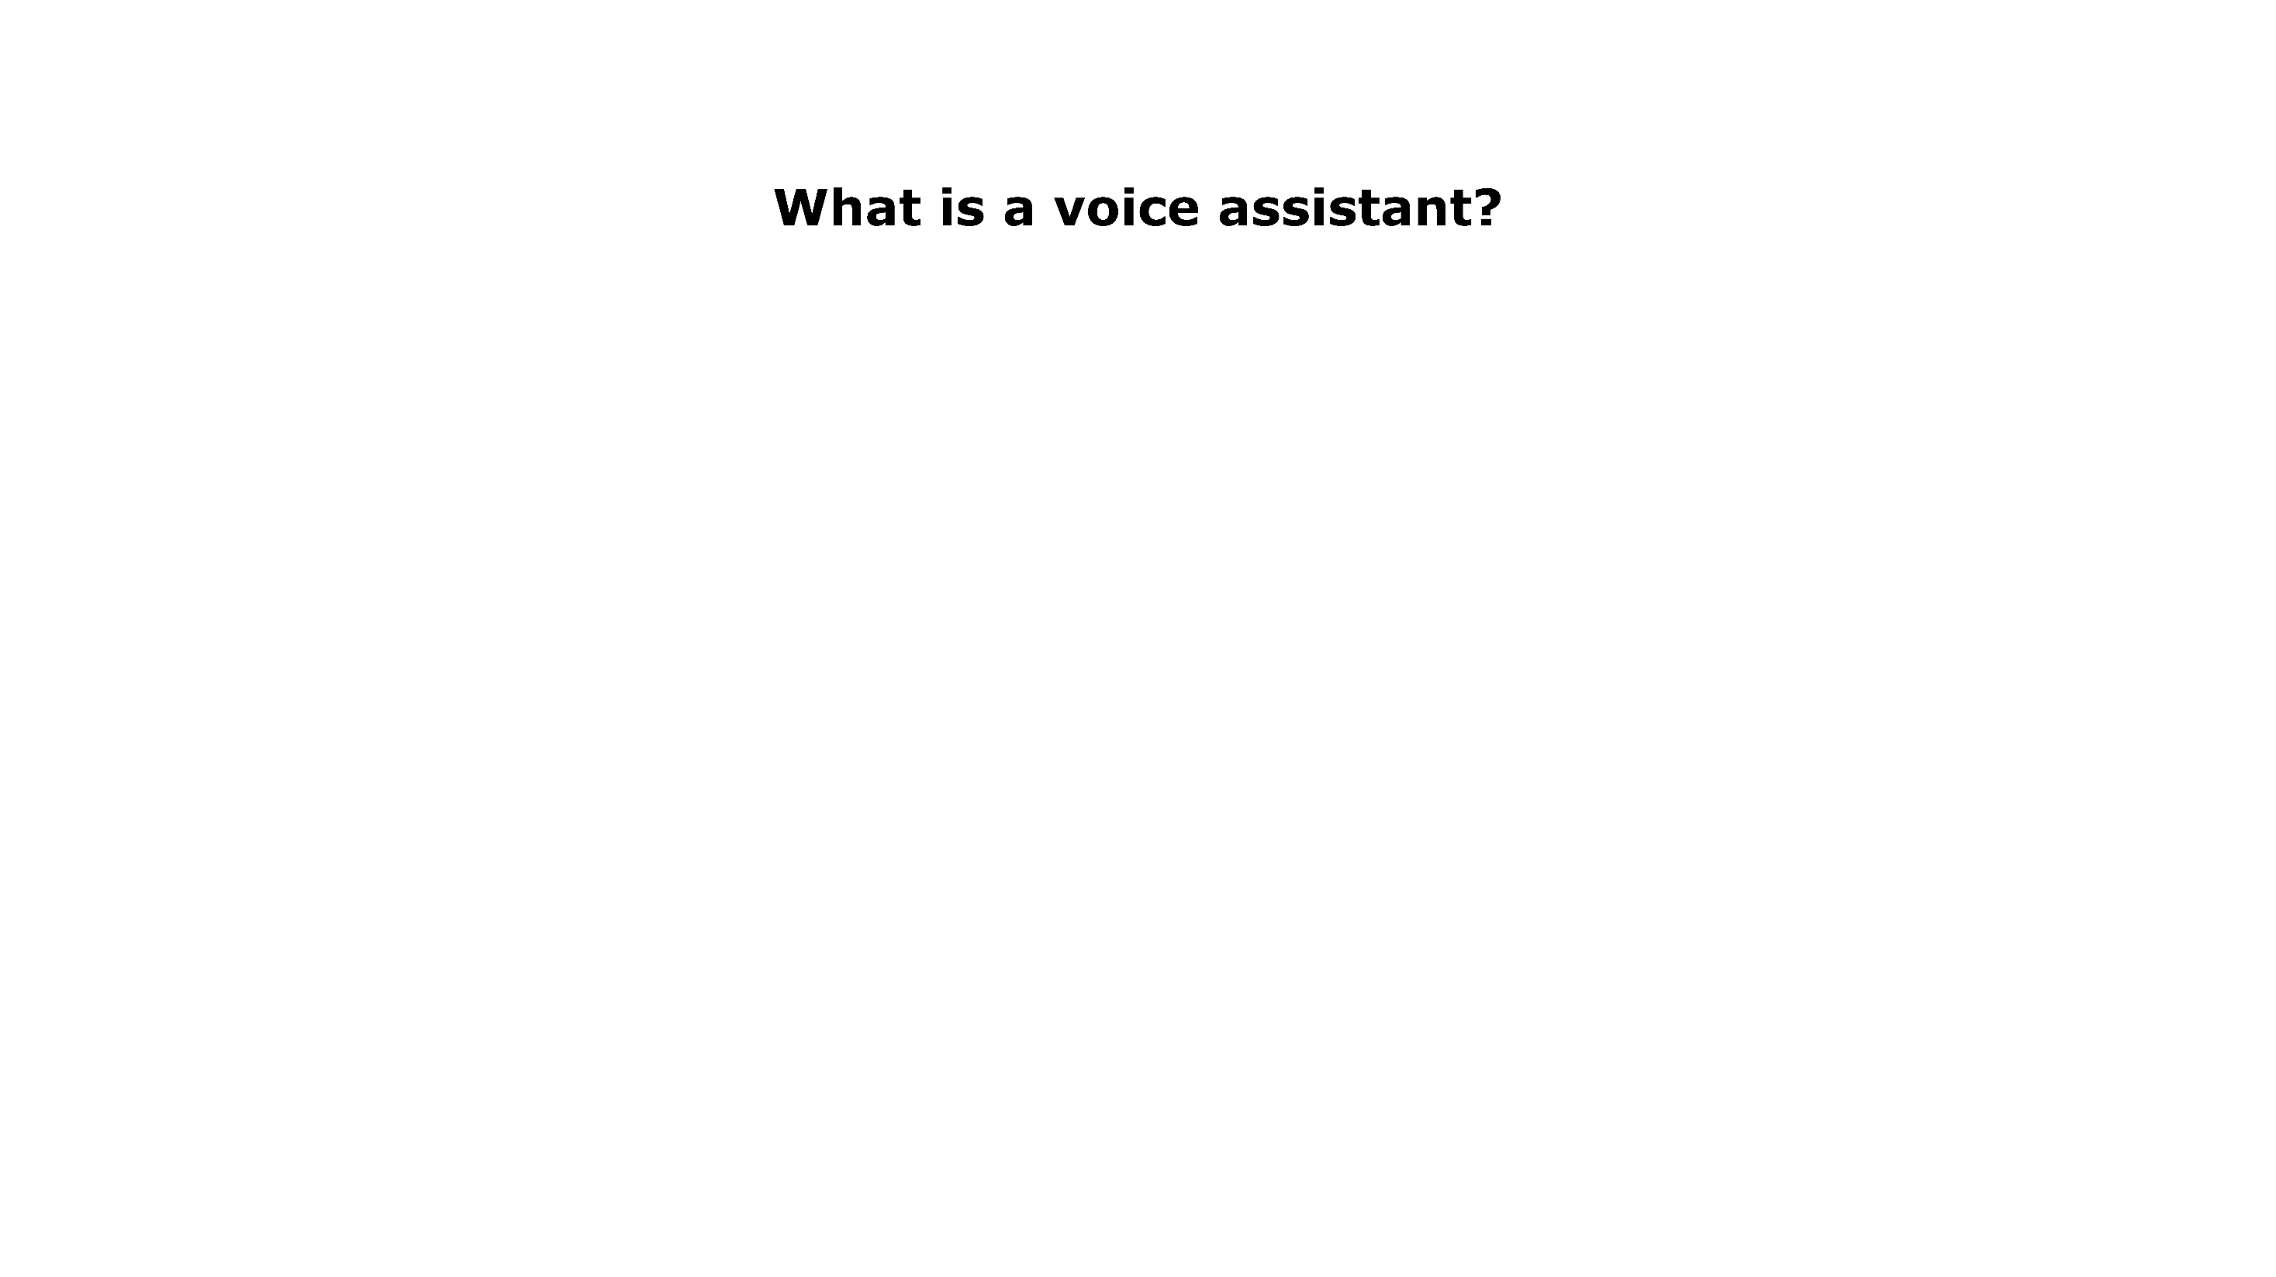







What is a voice assistant?

Slide 42



Gio asks the voice assistant to tell him a story.
Gio finds the story scary.

Slide 43








Evie asks the voice assistant a question.
She doesn’t understand the answer.

Slide 44







Finn asks the voice assistant to make some
farm animal noises.

Slide 45



Jia asks the voice assistant to tell her today’s news.
Some of the news doesn’t sound very nice.

Slide 46







Anna plays a game with the voice assistant.

Slide 47


Dev’s voice assistant starts speaking by itself.
No one asked it a question.

Slide 48
Tina asks the voice assistant to play her favourite song.

Slide 49








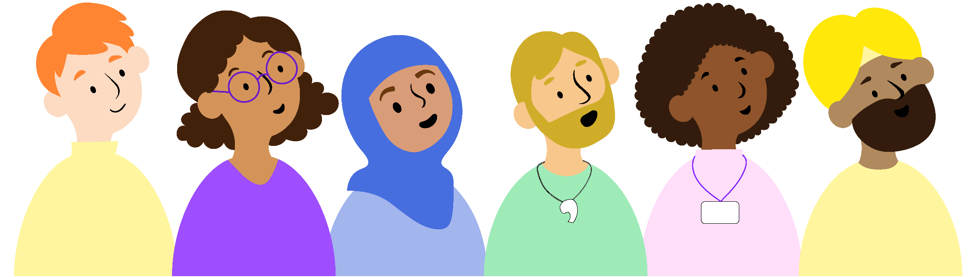
Trusted adults
Step-Dad
Teacher
Carer
Mum
Aunt
Step-Mum
Uncle
Dad

Slide 50





Abeni tricks the voice assistant into saying a mean joke about her younger cousin Olu.
Extension

Slide 51




Luis is struggling to find a fact for his homework.
His nan asks their voice assistant to help him find the fact he needs.
Extension

Slide 52





Hamza is with his younger brother Omar. Hamza asks the voice assistant to play a song.
The song has bad words in it.
Extension

Slide 53




Grace and Ada are asking their voice
assistant to play videos for them.
Grace asks it to play a video with lots of fighting in it. Ada didn’t want to see this type of video.
Extension

Slide 54




Billy is feeling upset, so Ling decides to ask the voice assistant to tell some funny jokes.
Extension

