Slide 1


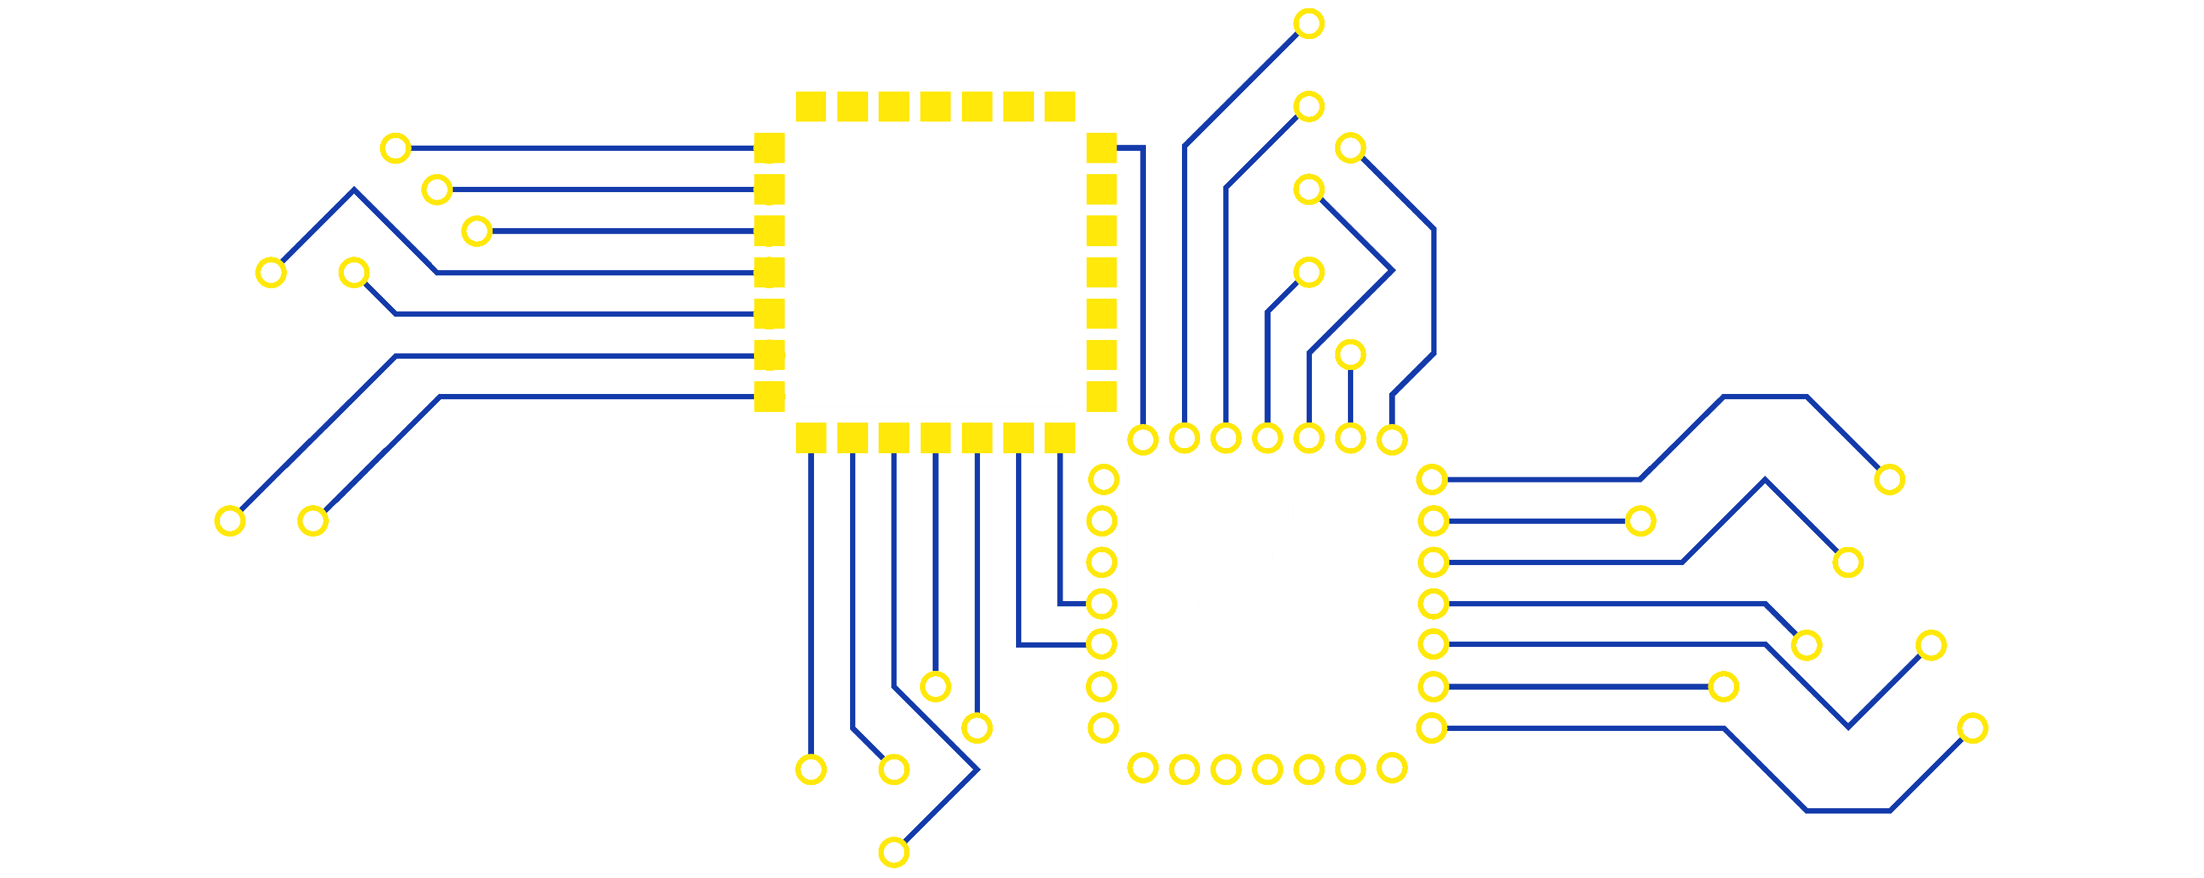

Slide 2

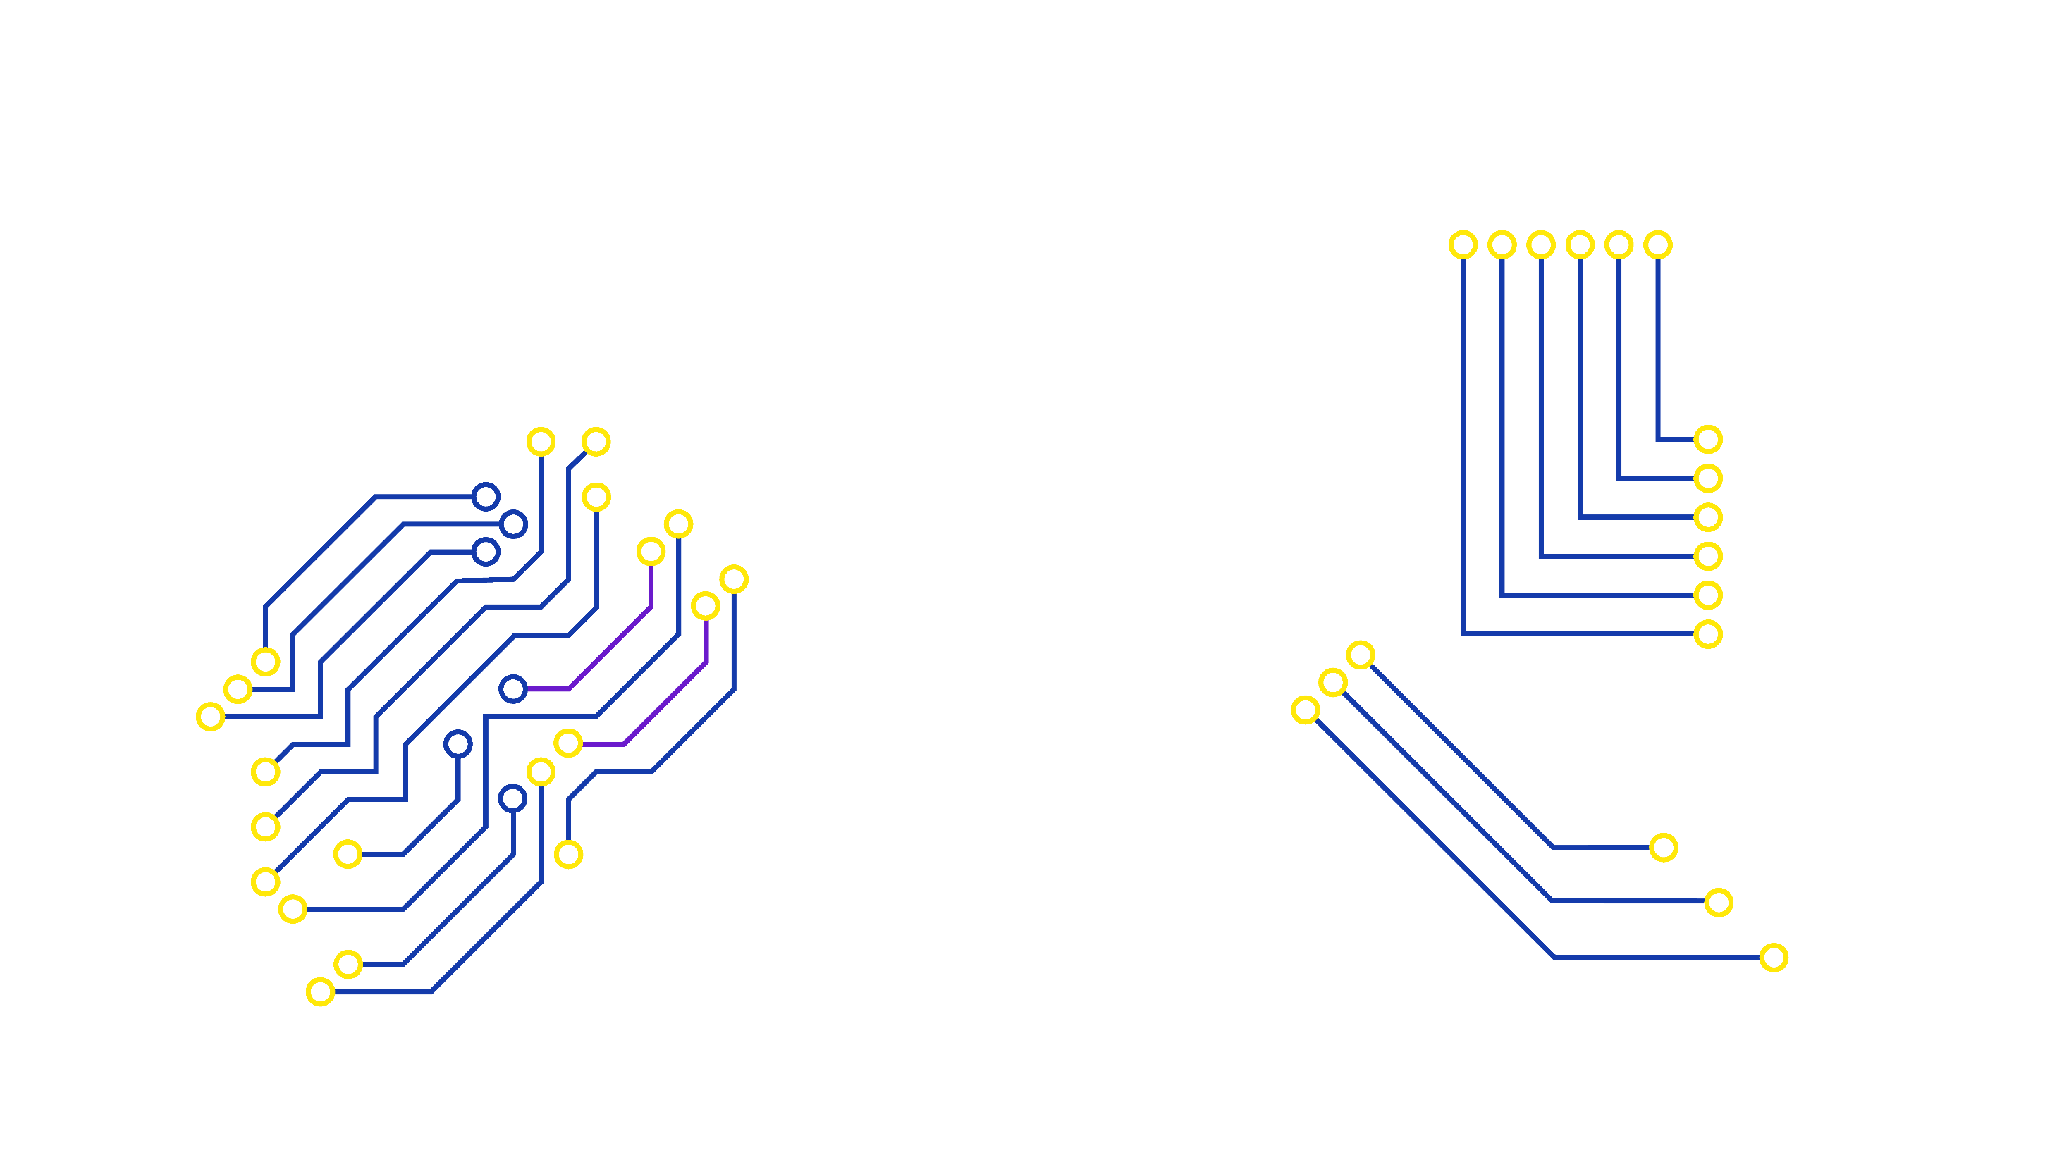

Okay or not okay?

Slide 3












To upset someone
To hurt someone
Responsible
Safe
Okay?
Not okay?
To trick someone
Kind
Fun
Unsafe

Slide 4

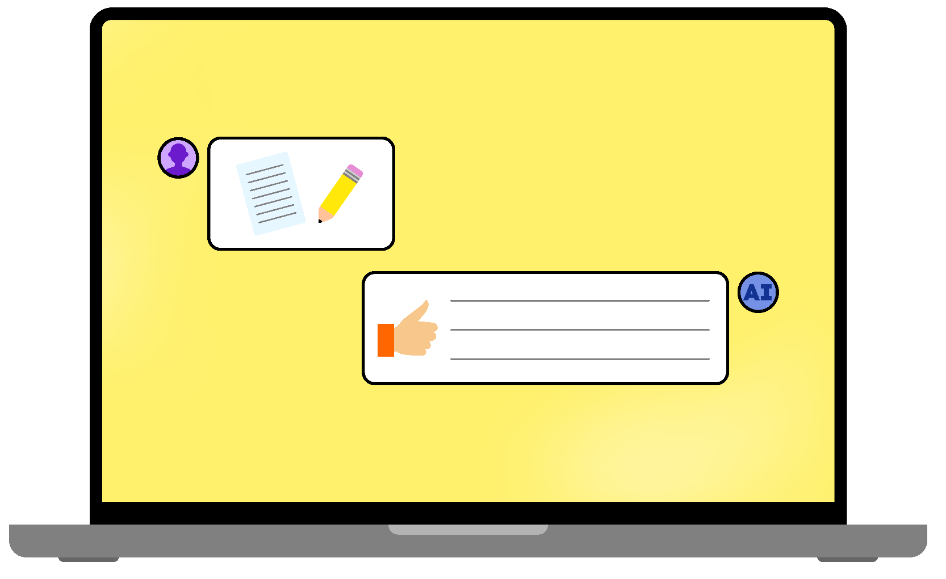


Using AI - okay or not okay?

Slide 5

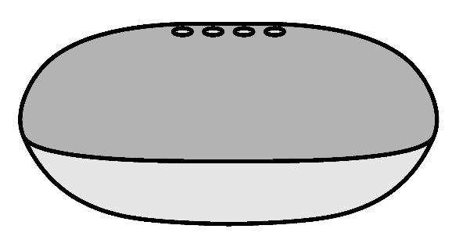
Use an AI voice assistant to tell you an interesting
fact about your favourite animal

Slide 6
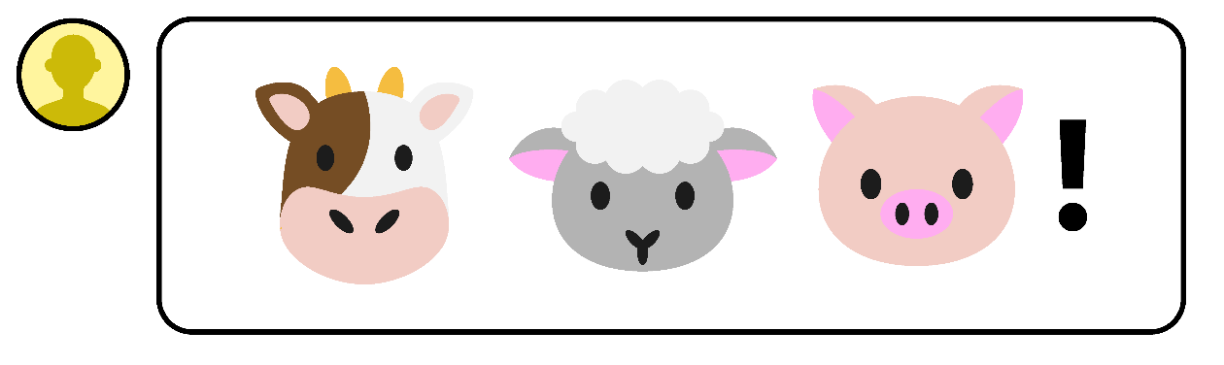

Use AI to create a joke about one of your friends
and then send it to them

Slide 7
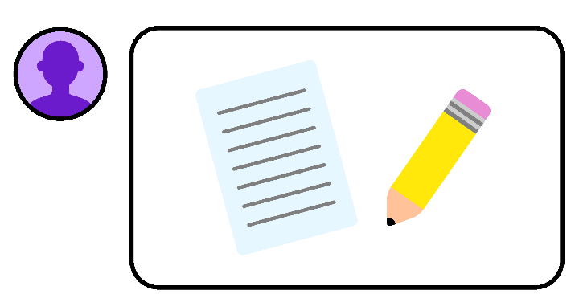
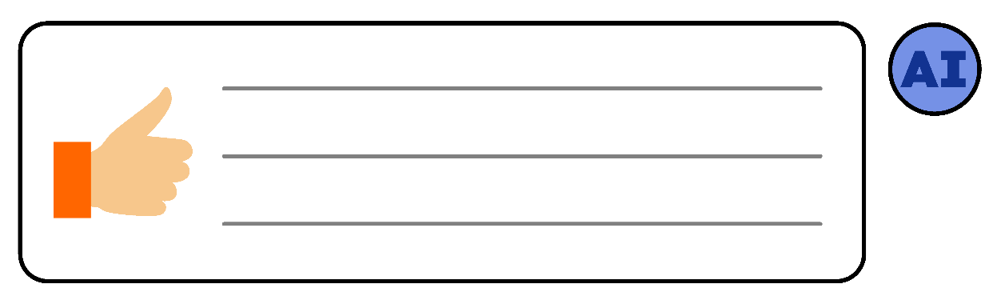
Use AI to complete a homework activity

Slide 8

Ask an AI voice assistant to tell you about a new game
that is coming out soon that you really want to buy

Slide 9
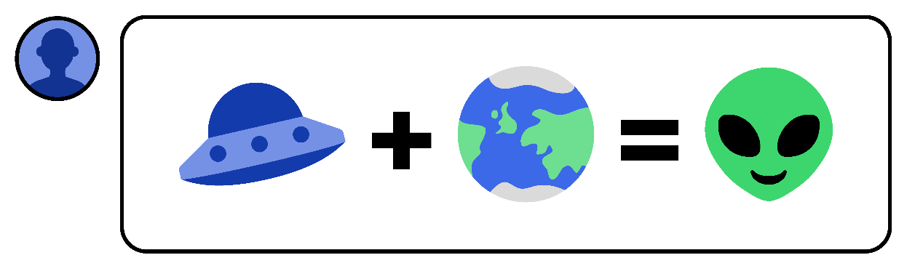
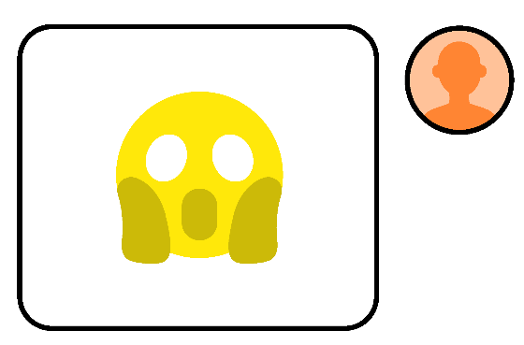
Ask AI to create a fake news story for you and
then show it to your friend, telling them that it is real

Slide 10


Ask an AI voice assistant to play the trailer
for a film that you’d like to see

Slide 11
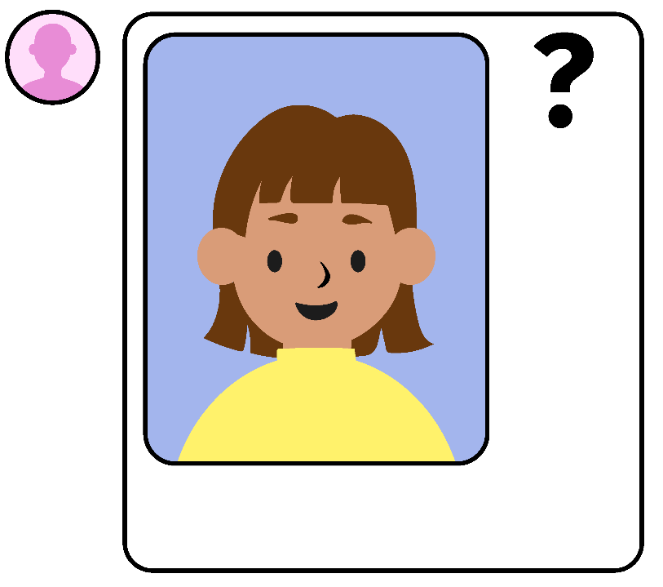

Use AI to edit a picture of your friend so that it makes them look
silly and then posting it in your group chat

Slide 12
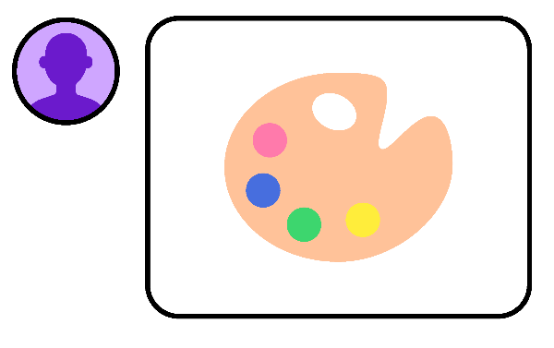
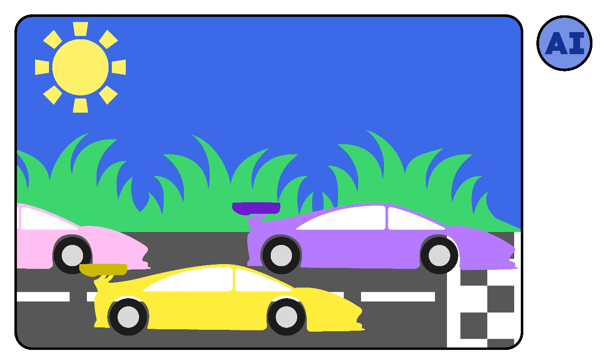
Ask AI to create a picture for a design competition
that your school has set up

Slide 13









Ask AI to create a piece of music for you

Slide 14

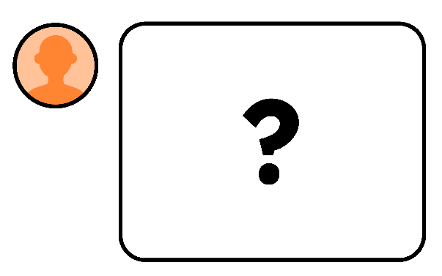
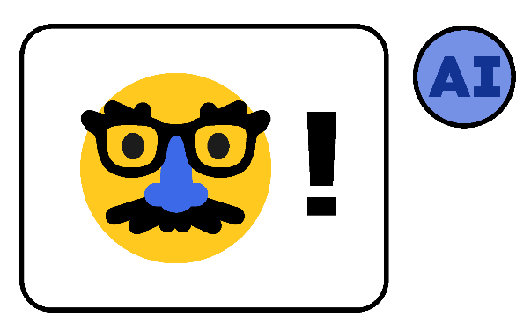

Ask an AI website to create a new character
and then speak to that character

Slide 15

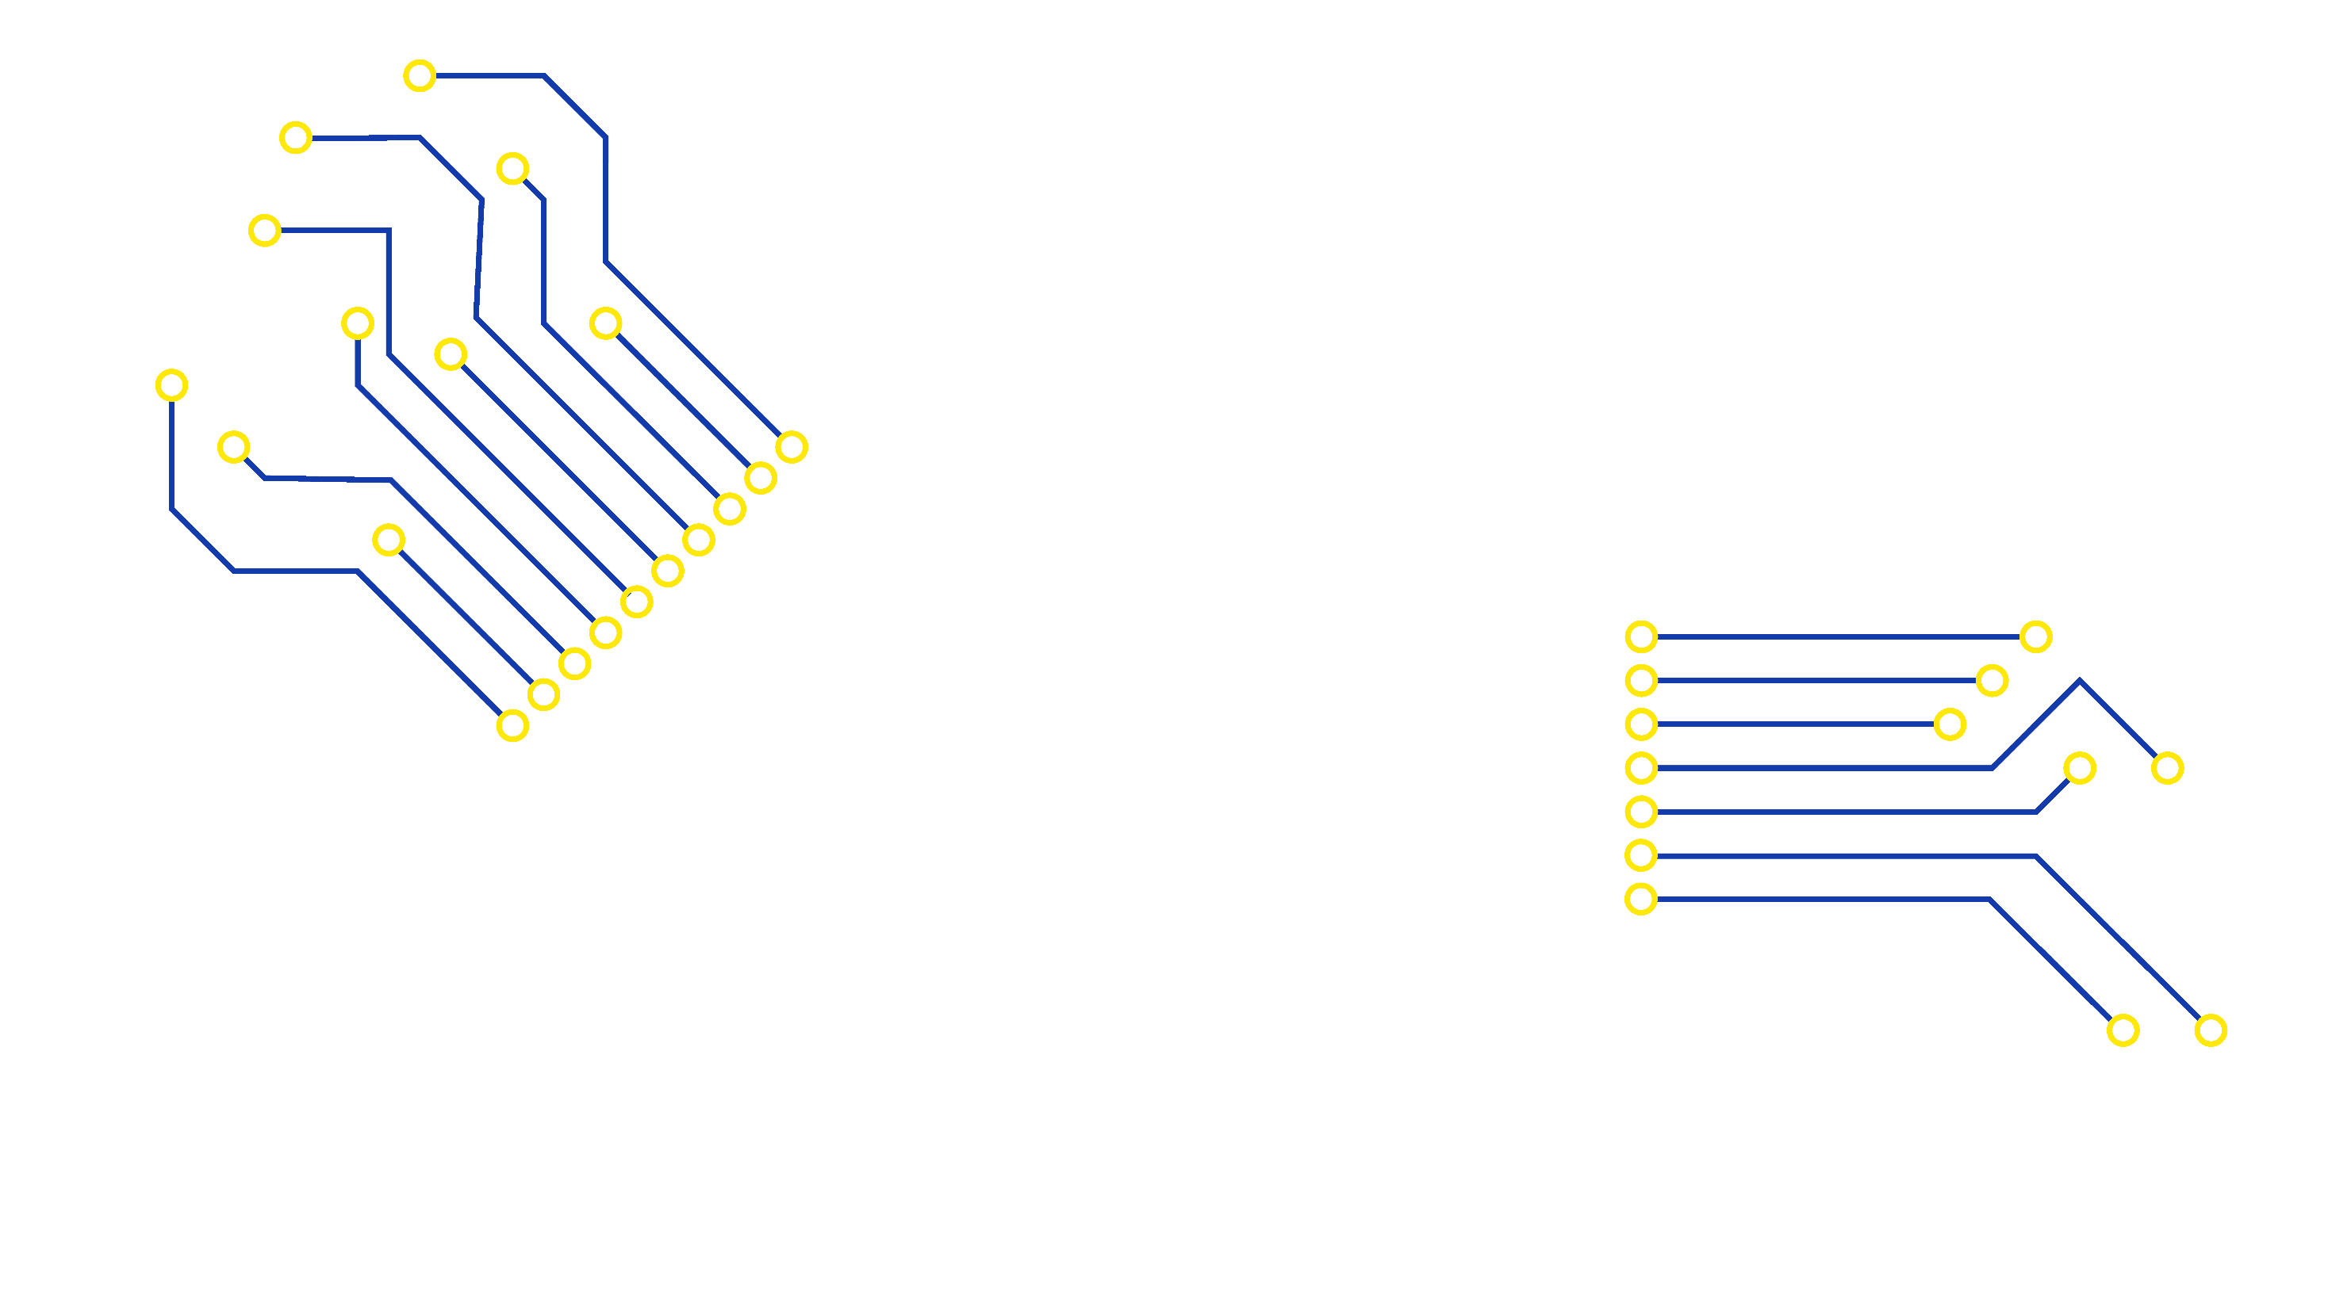
Responding to
misuses of AI

Slide 16






Slide 17


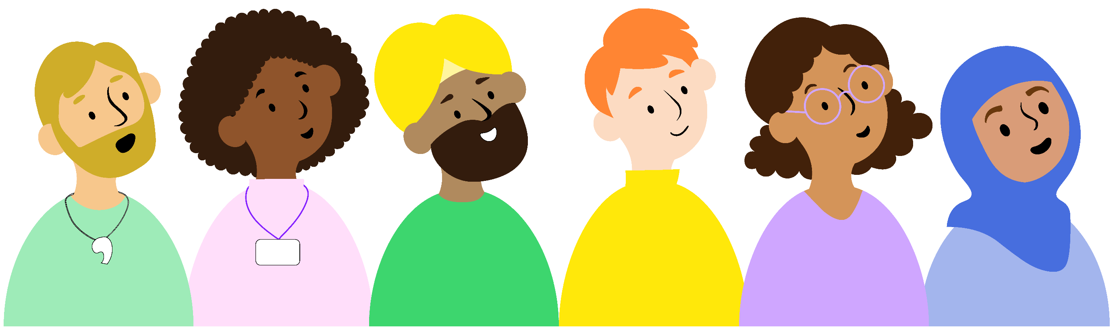
Talk to a trusted adult
Call Childline on 0800 11 11

Slide 18


Report to the platform

Slide 19



Shall we tell an adult together?
Do you want to talk?
Are you okay?
Support the victim

Slide 20

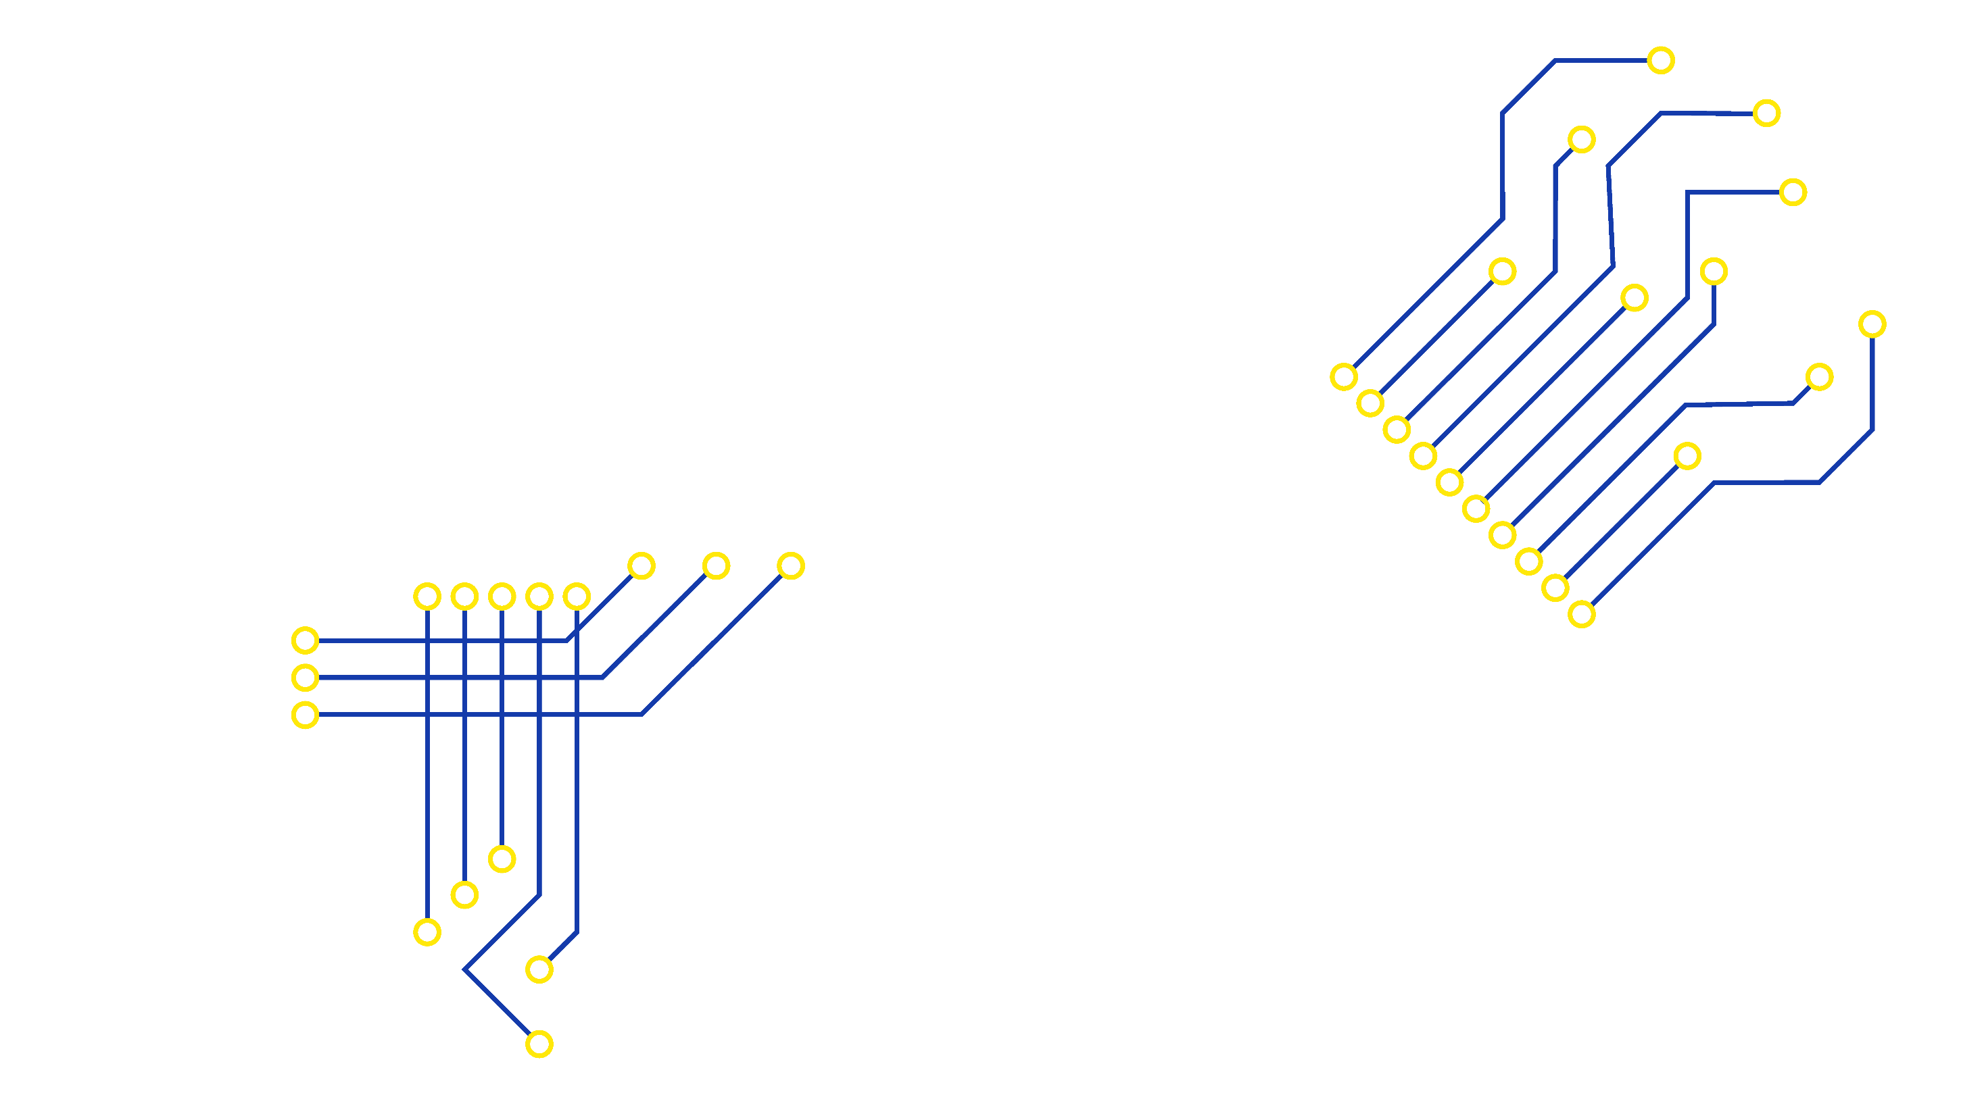
Pip’s problem

Slide 21


Pip’s problem
I am in a group chat.
A picture was shared of me.
They used AI to make me look
strange.
They keep laughing at me.
I feel upset.
What should I do?

Slide 22




Can you give some advice to Pip?
It is not okay for people to…
I’m sorry you are feeling…
You should…
Talk to a trusted adult, such as…

Slide 23
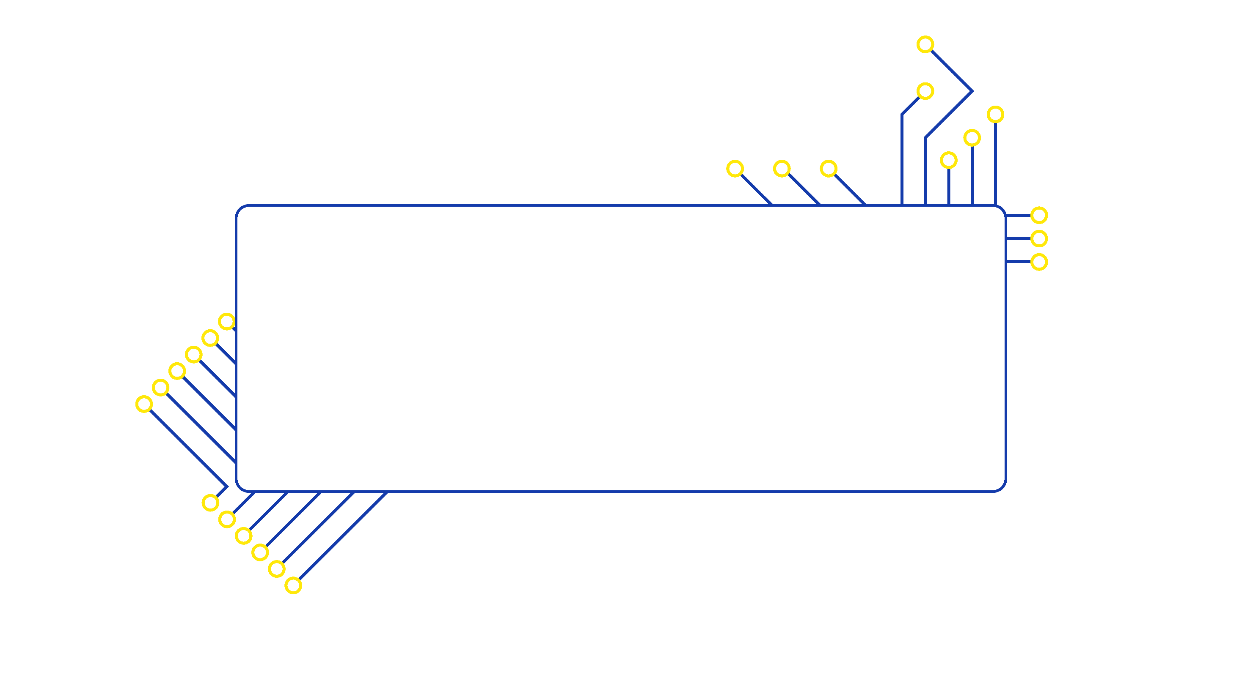
AI chatbots

Slide 24



What is an AI chatbot?
An AI chatbot is a computer program that you can
talk to.
It uses artificial intelligence to respond to what you say in a personalised way.
You might find chatbots in lots of different places like apps, games and websites.
Chatbots use AI to respond in a realistic way that sounds like a human.
Some might even seem like they have a personality, emotions or can remember what you’ve talked about before.
Some chatbots can be personalised to look and behave a certain way. They can feel like a friend or someone you know, but that is just how they are designed.

Slide 25







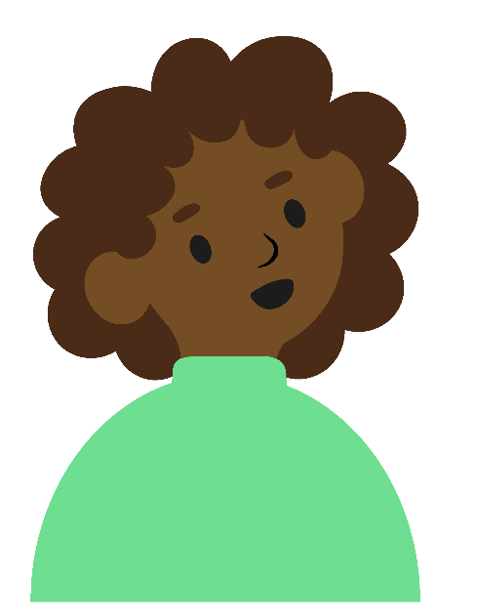
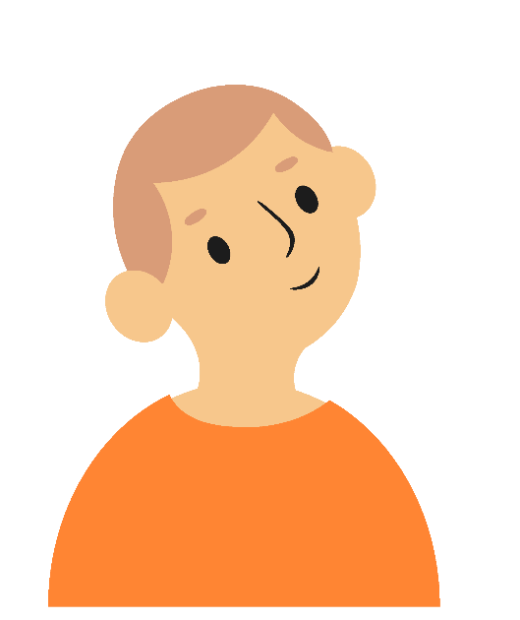


People might use AI chatbots for a variety of reasons
I talked to an AI chatbot about
my favourite book
and it recommended other books I
would like
A chatbot answered my question
when I was stuck with something on
an app
AI chatbots help me by answering questions
I got a chatbot to
test me on my
times tables
I practise speaking
a different language with an AI chatbot

Slide 26


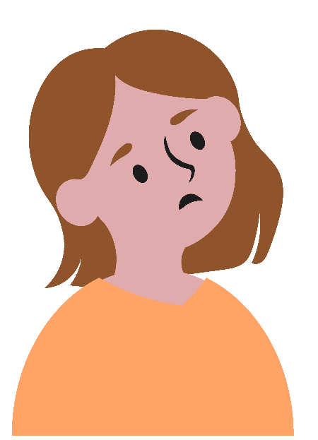
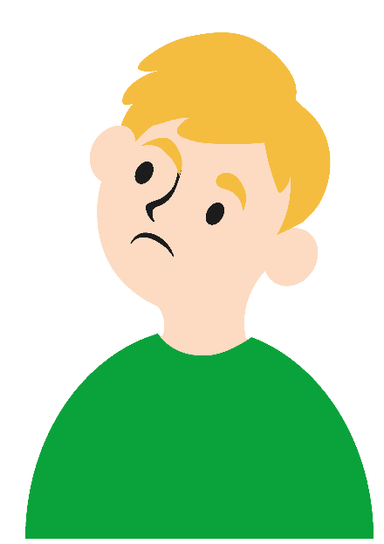
Some people use chatbots for help and support with their emotions or difficult situations.
If I don’t know what to do in a stressful situation, I ask an
AI chatbot
If I’m feeling down, I talk to an AI chatbot
Why might talking to a person be better?

Slide 27


An AI chatbot doesn’t have emotions
TRUE
FALSE

Slide 28


An AI chatbot doesn’t have emotions
TRUE
FALSE
Some chatbots may seem like they have emotions, but they have just been programmed this way. They cannot think or feel for themselves so they can’t understand or care about other people’s feelings like a person can.

Slide 29
Talking to a chatbot is like talking to a friend
TRUE
FALSE

Slide 30

Talking to a chatbot is like talking to a friend
TRUE
FALSE
Talking to an AI chatbot can be fun and entertaining. It might make
jokes with you or express interest in your hobbies or life. However, an AI chatbot is not a person and has only been programmed to seem friendly because it provides a better experience for the user. Talking to a friend is different because you are building a relationship with another person and you both care for each other.

Slide 31
An AI chatbot can understand my problems
TRUE
FALSE

Slide 32
An AI chatbot can understand my problems
TRUE
FALSE
AI chatbots have access to huge amounts of information on many different topics, which can make it seem like they are an expert or know everything. When you ask a chatbot for advice, it may seem like it is helpful, however it does not understand your problems like a person can and may even give false information. A person like a trusted adult or doctor uses their knowledge on a topic and their understanding of you and your feelings to help you with specific problems.

Slide 33
AI chatbots always give safe advice
TRUE
FALSE

Slide 34
AI chatbots always give safe advice
TRUE
FALSE
When you speak to an AI chatbot, they can often find helpful information to share with you. However not all advice given by chatbots is safe
and reliable, especially if you are in a difficult or dangerous situation. When you are upset, worried or confused about something, it can be harder to think clearly. Talking to a person means you can understand those emotions and start to feel better. They can also help you consider different options for what to do next, check in with you later or help you get more support you may need.

Slide 35
An AI chatbot can help me more quickly than a person can
TRUE
FALSE

Slide 36
An AI chatbot can help me more quickly than a person can
TRUE
FALSE
A chatbot can usually respond to you very quickly, which can be helpful
in some situations. However, this does not mean a chatbot is the best place to go for help and advice. Think about fast food. It might be tasty and convenient, but it’s not always healthy and you shouldn’t rely on it
for all your meals. The same goes for a chatbot. It can be fun to use one occasionally or to help with some tasks, but you shouldn’t rely on it for everything. A trusted adult is a much safer place to go for help and advice.

Slide 37


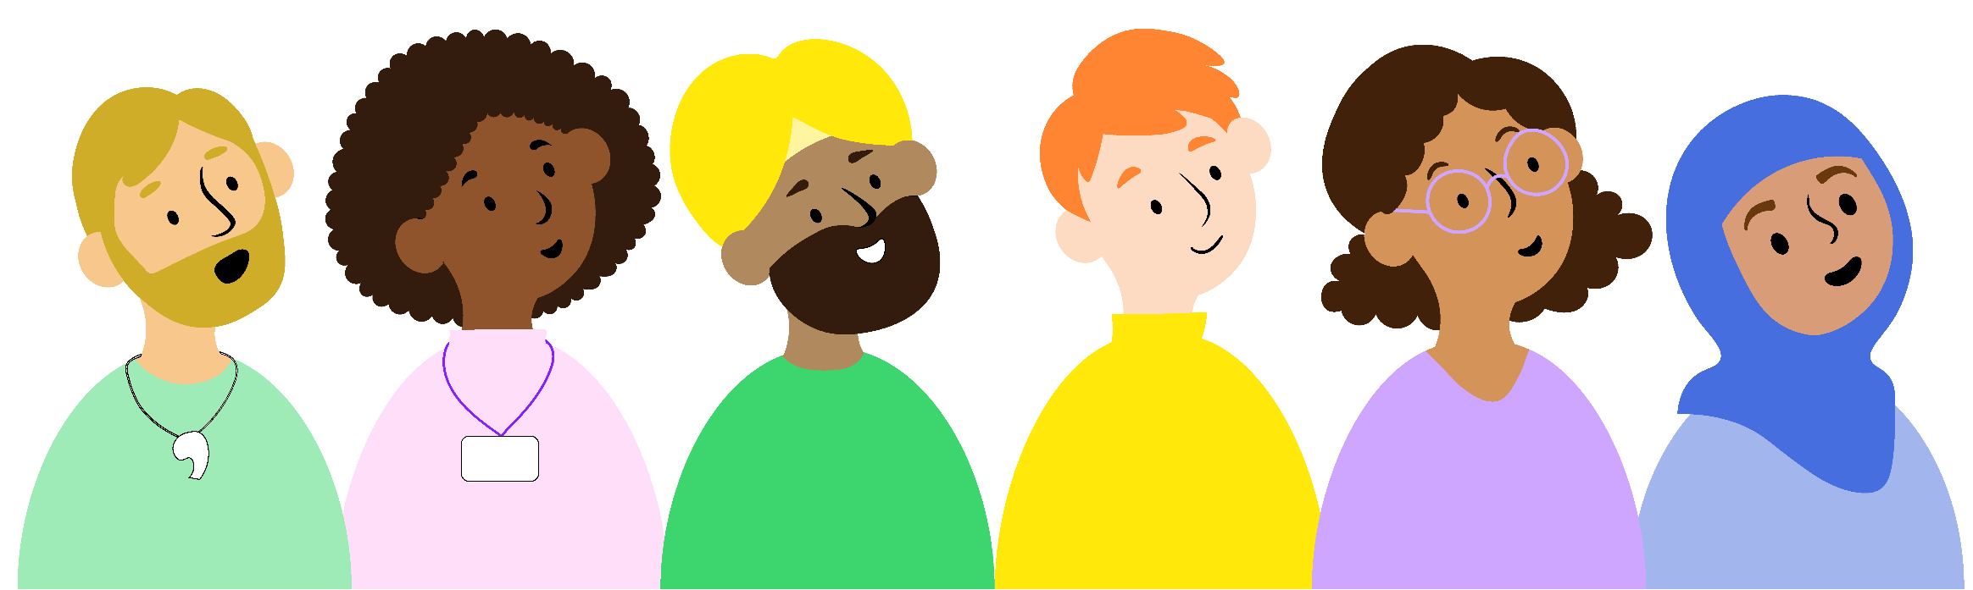
Who can you talk to?
Trusted adult at home or school
A club leader or youth worker
Health professionals such as a doctor
Childline on 0800 1111

