Slide 1
Safer Internet Day 2026
Assembly for 11 to 18s
Under the slides you can find a script to help with delivery. To print the script, under print settings select print ‘Notes Pages’.

Slide 2



Safer Internet Day 2026
Notes:
Hello, everyone. In today’s assembly, we’re going to be talking about Safer Internet Day.

Slide 3






What do you think Safer Internet Day might be about?
Notes:
Safer Internet Day is held every February in over 170 different countries. The goal of Safer Internet Day is to call on people across the world to work together to make the internet a safer and better place for all, but especially for young people. In the UK, the UK Safer Internet Centre runs a campaign especially for the day which aims to start a national conversation about using technology safely and positively. Last year, over half of children and young people in the UK heard about the campaign, but it also involves and influences government, charities, police forces and tech companies including social media and gaming platforms.

Slide 4



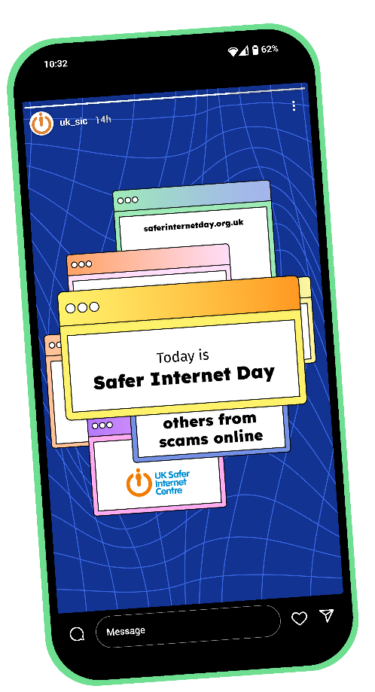
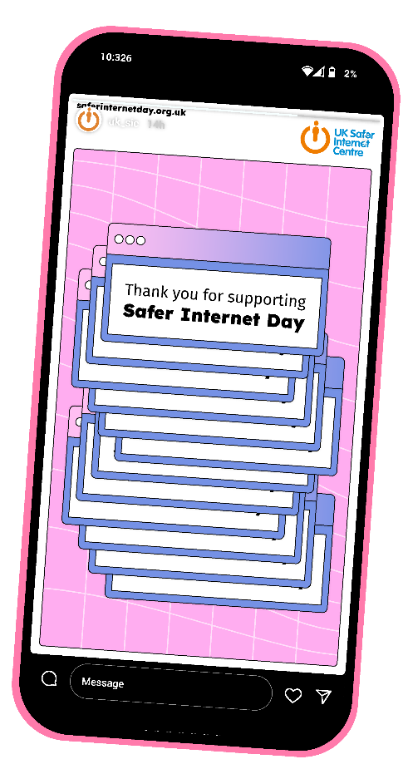
Notes:
In fact, in 2025, over 1,700 organisations across the UK delivered activities for the day. It was profiled on national media, including on the BBC and ITV. Young people met with Government Ministers and other organisations including children’s charities and representatives from the tech industry at our event in London. Millions more people engaged with the day online: we saw people across the UK sharing their celebrations on Twitter and Instagram, and over 86,000 young people tested their online safety knowledge with our quizzes. By being part of this assembly, you’re joining countless others in making Safer Internet Day 2026 the biggest yet!

Slide 5

AI describes technology and computer systems that have been designed to complete tasks that would have previously required human thinking.
How many examples of
AI use can you think of?
Notes:
This year, Safer Internet Day is focusing on artificial intelligence or AI. AI is an umbrella term, which means it covers many different things. Generally, AI describes technology and computer systems that have been designed to complete tasks that would have previously required human thinking.
AI systems may appear to be able to think for themselves, but this is just the way they have been developed. AI is trained or programmed to use data (or information) to complete complex tasks such as recognising patterns, making decisions and generating new content.
How many examples of AI use can you think of? [If appropriate to do so, take responses from learners.]

Slide 6










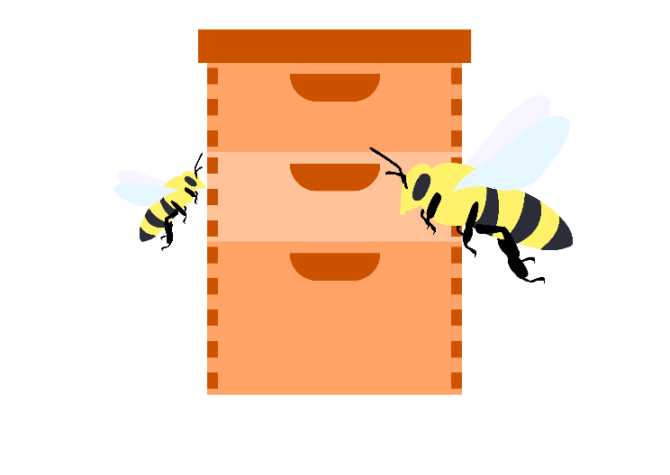

How is AI being used?
Detecting illegal
logging in the Amazon
Guiding brain surgeons
Tracking sustainable fishing
Translating stories into sign language
Narration for people with visual impairments’
Analysing honeybee hives
Notes:
You might be familiar with how AI is already being used in everyday life, for example powering virtual assistants like Alexa and Siri, on chatbots like Gemini or ChatGPT, or to inform algorithms that recommend content on social media and streaming services. But did you know AI is being used in lots of other incredible ways?
AI can prevent environmental crime in the Amazon by helping to detect illegal logging or mining and delivering real-time alerts to stop it.
AI can also be used to guide surgeons on how best to treat brain tumours whilst they are in surgery. The tool can rapidly decode a tumour’s DNA, which normally would take days.
One tool allows fishers to identify and record their catches to make sure they are fishing sustainably using just a photo taken on their phone.
An AI powered app helps deaf children to learn to read by scanning the pages of stories and translating it into sign language.
AI has also been used to analyse honeybee hives to try and prevent the global decline in their populations.
One AI powered app can narrate the world around someone, so the blind and low vision community can have assistance with daily tasks like reading and identifying products.
https://aiforgood.itu.int/meet-the-winners-for-the-2025-ai-for-good-impact-awards/
https://hms.harvard.edu/news/ai-tool-decodes-brain-cancers-genome-during-surgery
https://worldfishcenter.org/updates/smartcatch-wins-un-prize-ai-innovation-climate-smart-fisheries
https://www.aardman.com/interactive/storysign/
https://www.oracle.com/corporate/pressrelease/ai-smart-hive-networks-101618.html
https://www.seeingai.com/
References to be added in notes on slides

Slide 7











Replacing
jobs?
Completing coursework?
Deepfakes?
Inaccurate advice?
Environmental impact?
Notes:
However, whilst there are many examples of AI being used for good, lots of people also have concerns about the wider impact of AI technologies, now and in the future. For example:
Some young people are worried about AI replacing jobs and this making it harder to find employment in the future.
Schools and universities are concerned that students may be using AI to write essays or produce coursework, which will also impact their own skill development.
Some people have been the victim of deepfakes – using AI technology to generate realistic videos that show things that never actually happened.
Children’s charities and mental health professionals are worried about the use of AI chatbots to seek medical or mental health advice, which may not be safe or accurate.
Some people are worried about the resources AI technology uses and the long-term environmental impact this might have.

Slide 8


We all have the right to decide the extent to which we want to engage with
AI technologies.
Notes:
As individuals, we all have the right to decide the extent to which we want to engage with AI technologies.
Some people might want to build a career out of developing or using AI.
Some people might interact with it less frequently, only using it if they have a specific task it can help with.
And some people may choose not to use it all. However much you decide to use AI, all of these are normal and valid choices.

Slide 9








Understanding consent
Thinking critically about online content
What does safe and responsible use of AI technology mean?
Reflecting on how using AI makes you feel
Knowing where to get help
Thinking about how your use makes other people feel
Learning about the ethics of AI
Notes:
And if you are using AI, it’s important to remember that as with any technology, we all have a duty to use it safely and responsibly.
What does safe and responsible use of AI technology mean? How do you decide?
[Take answers from learners if appropriate to do so. Click to reveal answers]
It means thinking about how your use of AI might make other people feel. Even something intended as a joke could be harmful or upsetting.
It means understanding consent, and only using AI in a way that other people consent to as well as considering what your own boundaries are.
It means thinking critically about the content or information AI gives you. It may not always be reliable or accurate.
It means learning about and reflecting on the ethics of AI, and deciding how you feel about its wider impacts on society.
It means reflecting on how use of AI impacts your wellbeing, and where you may feel attached to or reliant on an AI tool.
It means knowing where to get help, if you need it and speaking to a trusted adult if you need support.

Slide 10



Getting Help
Note to educators: Add names, words, or even photos to this slide to show learners who they can go to if they have an online safety concern
Notes:
Here at [name of school/setting] we want to make sure you are safe, in all parts of your life. If something you’ve seen online or something that happened online is worrying you or affecting you, please come to us for help and advice. We’ll listen carefully and work with you to decide what the best thing to do next might be.

Slide 11







How do you feel about AI?
Do you think it’s a force for good?
Or do you have concerns?
And what do you think adults need to know about how AI is impacting your lives?
What support would you like to be able to use it safely and responsibly?
Notes:
As young people, you have the
right to express your views, feelings and wishes in all matters affecting you and have these considered and taken seriously.
Artificial intelligence is an evolving technology, which is likely to change all our lives.
This Safer Internet Day, we want to start a conversation about your opinions and experiences of AI technology. Talk to your friends, talk to your family, talk to us at [name of school/setting]… How do you feel about AI? Do you think it’s a force for good? Or do you have concerns? What support would you like to be able to use it safely and responsibly? And what do you think adults need to know about how AI is impacting your lives?
[Depending on time available, you could choose one of these questions to facilitate a discussion during the assembly]

Slide 12
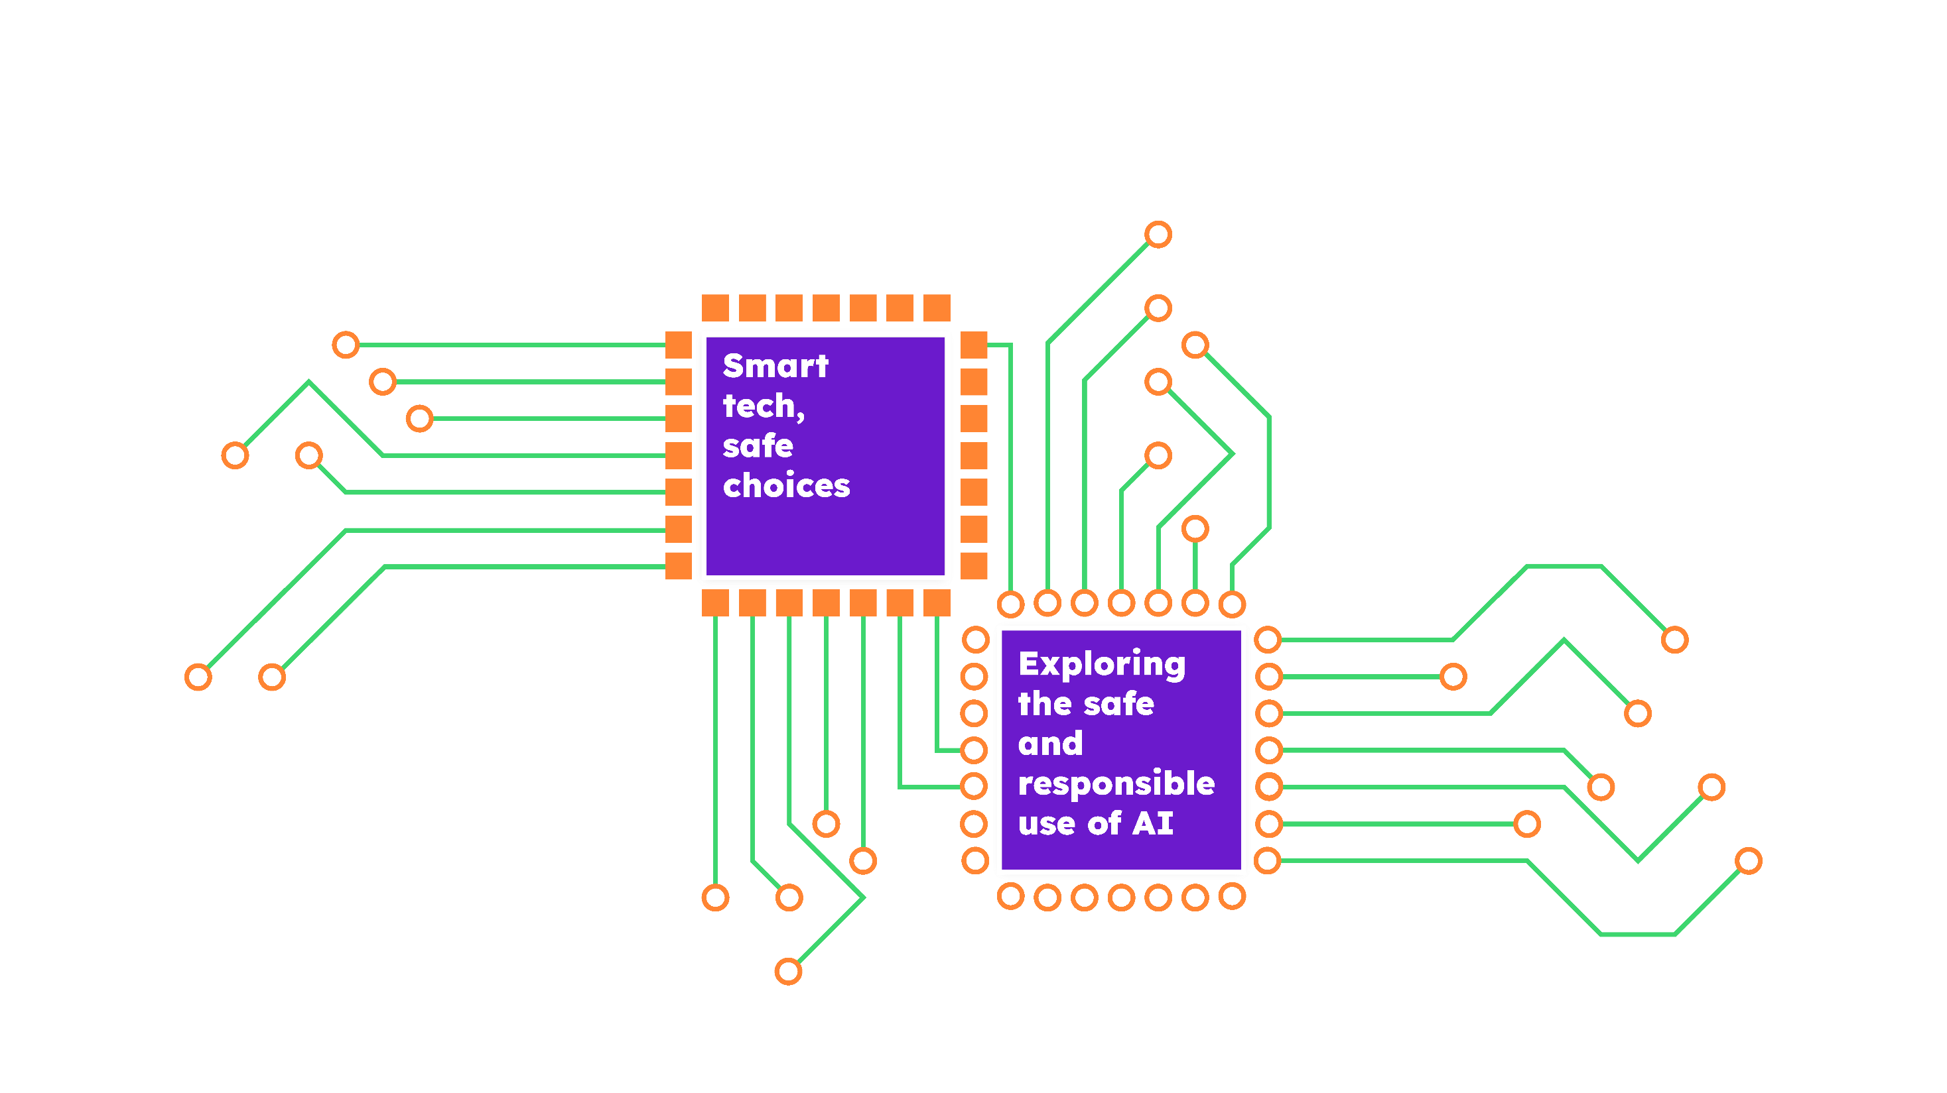

Notes:
I look forward to talking with some of you, and to hearing more about the conversations you have today, and moving forward.
Happy Safer Internet Day!

