Slide 1
Safer Internet Day 2026
Assembly for 4 to 11s
Under the slides you can find a script to help with delivery. To print the script, under print settings select print ‘Notes Pages’.

Slide 2



Safer Internet Day 2026

Slide 3
Have you celebrated
Safer Internet Day before?
Notes:
Hello everyone. In today’s assembly we’re going to be talking about Safer Internet Day. Have you celebrated Safer Internet Day before? What do you think Safer Internet Day is about?
Safer Internet Day happens every year and is a time for everyone to think about how we can make the internet a safer place.

Slide 4





What do you think Safer Internet Day might be about?
Notes:
Safer Internet Day is held every February all around the world. Last year, over 170 different countries celebrated the day! Safer Internet Day is a chance to think about any worries we might have about using technology and the internet, but it’s also about celebrating all the fantastic things technology can help us with. Last year, over half of the children in the UK heard about or joined in with Safer Internet Day.

Slide 5



Charities
The government
Sports Clubs
Companies who make your favourite apps and games
The police
Notes:
And it’s not just schools who join in with the day, lots of other people get involved too, including the government, lots of charities, sports clubs, the police and even the companies who make your favourite apps and games. By participating in this assembly, you’re joining thousands of others in celebrating the day!

Slide 6
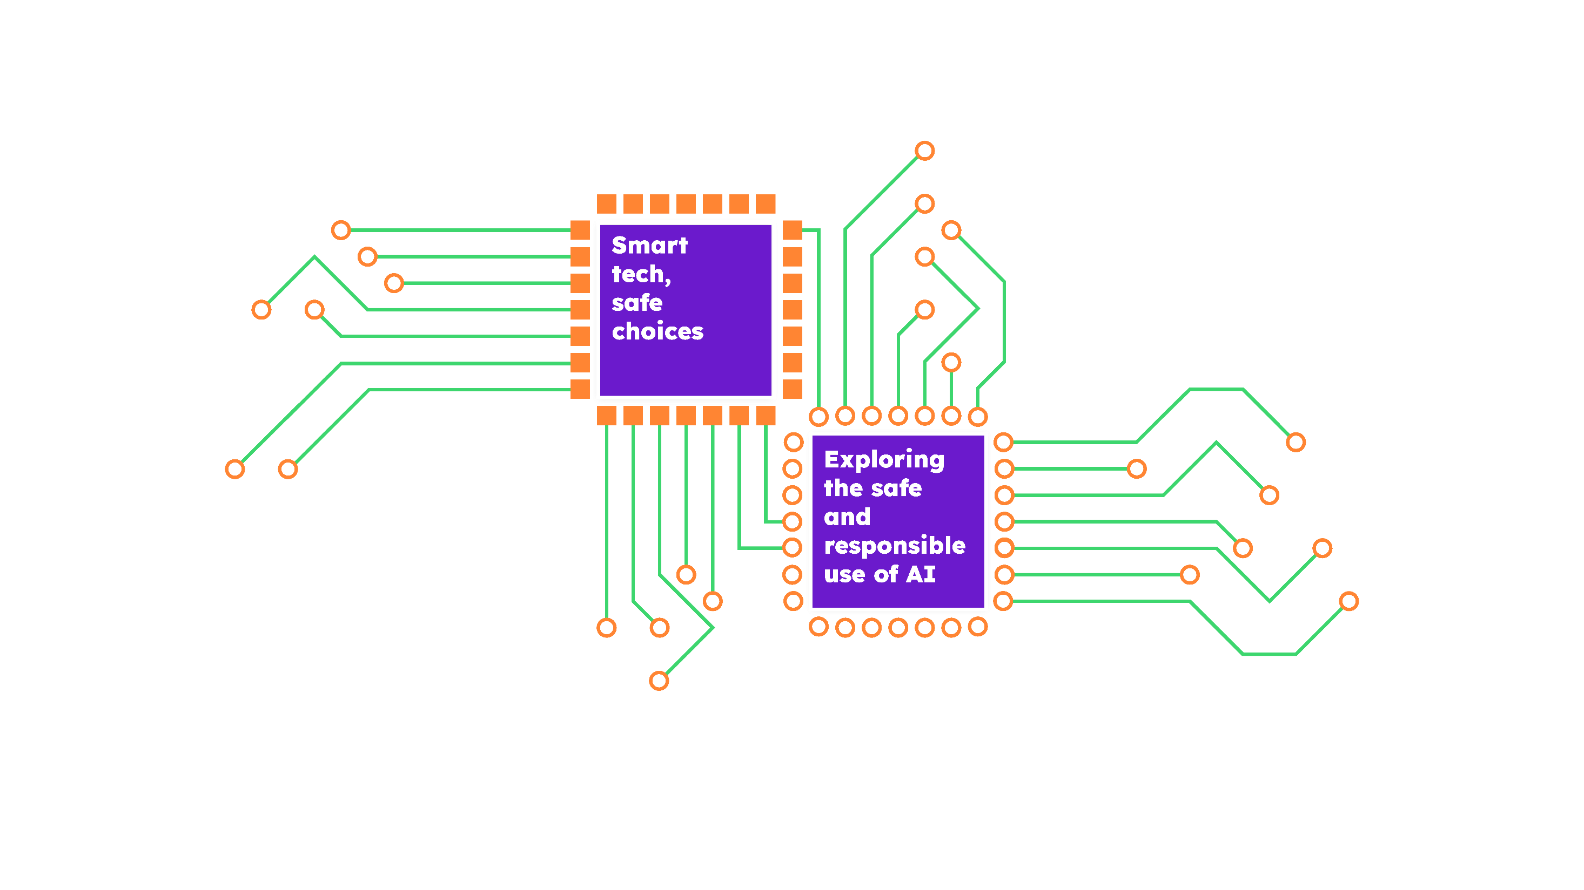


Notes:
This year for Safer Internet Day we are thinking about an exciting type of technology: AI. Who can explain what AI is?
[Take responses from learners.]

Slide 7
AI is a type of computer, which has been designed to try and do some of the things a human brain can do
Notes:
Great answers, everyone – AI stands for artificial intelligence. Artificial intelligence is a type of computer system, which has been designed to try and do some of the things a human brain can do.

Slide 8





‘They help us think, feel and make decisions’
‘Our brains are amazing!’
‘They use information from the world around us’
Notes:
Our brains are amazing! They are working all the time to help us think and understand things, move and talk, feel emotions and make decisions. Our brains use lots of information to help them do these things – signals and senses from our body, like what we can see and hear, but also from the world around us, and even things we’ve learnt in the past. Brains are really good at making connections and spotting patterns.

Slide 9


AI can be trained to do some
of the things a human brain
can do, like spot patterns and make decisions.
Notes:
Over time, computer scientists have developed AI to try and do some of the amazing things our brains can do. AI uses information too, but it’s normally called data. AI can be trained to spot patterns and make certain decisions, and as the technology improves, it is being used in all kinds of exciting ways.

Slide 10
























Notes:
If you have ever used a voice assistant, like Alexa or Siri, then it was probably using AI.
AI is used to help recommend new TV shows or films for you on apps like Netflix and Disney+.
Like a search engine, you can use AI to find information. On Google now, you might see an answer from AI at the very top of your search.
Some AI can even create art, photos and music! It can do this because AI is trained on lots and lots of examples, which are labelled so it can start to spot patterns. For example, lots of pictures of sunflowers have yellow petals, so if you ask AI to create a picture of a sunflower, it will follow that pattern and create a picture with yellow petals too.

Slide 11


AI is just a type of computer designed
to look like it can think
There are lots of things you can do that AI can’t.
Notes:
It’s important to remember that AI is different to a human brain. It’s still just a type of computer and has only been designed to look like it can think. But it can’t have new, creative ideas like you can, it can’t feel or understand emotions, and it can’t dream or use imagination.
AI is like any technology – we can use it to do amazing things, but we also need to remember to use it safely and responsibly, in a way that makes you and other people feel good.
Let’s look at some examples to see if we can decide how to use it safely…

Slide 12



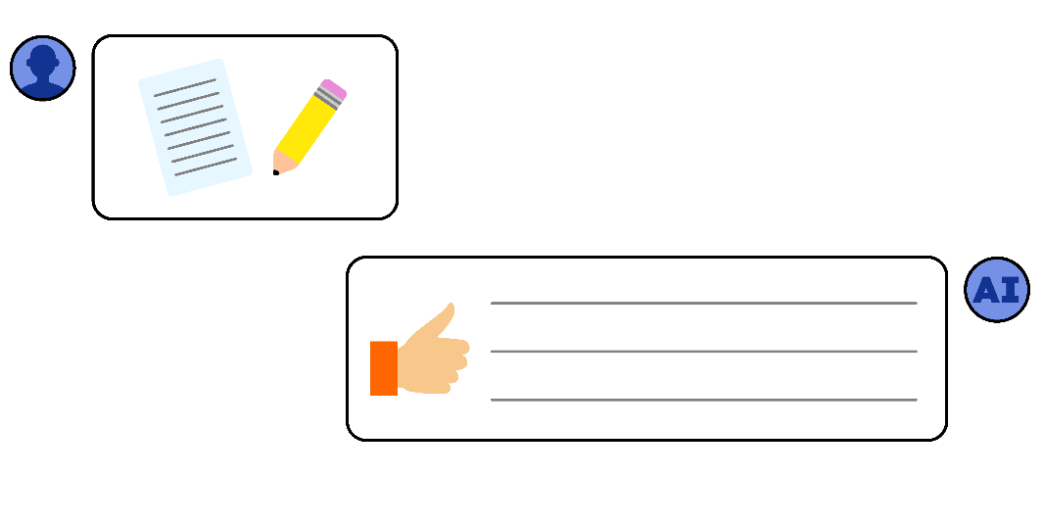
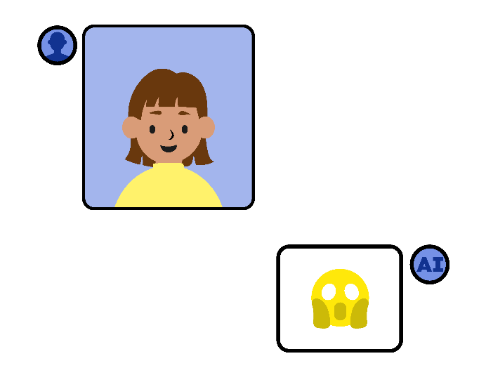
‘Sian uses AI to translate when
she talks to her friend’
‘Manu uses an AI speaker to play music’
‘Rory uses AI to help
with his homework’
‘Issa uses AI to create nicknames
for her classmates’
Notes:
Sian uses AI to help her talk to a new classmate who has moved from another country. They don’t speak the same language, but AI can help translate! Is this a good use of AI?
Manu uses an AI speaker to play a song for his baby sister when she’s crying. They dance to the music together! Is this a good use of AI?
Rory uses AI to help with his history homework. He types in the questions, and AI tells him the answers. He’s not sure if this is cheating, and some of the answers don’t look right… Is this a good use of AI?
Issa uses AI to make up nicknames for her classmates. She posts them in the group chat to make people laugh, but some people are upset.
Is this a good use of AI?

Slide 13






How can you stay safe when you use AI?
Check information to make sure it’s reliable
Talk to a
trusted adult if
you are upset
or worried
Think about
how your use
of technology makes other people feel
Ask a trusted adult before using a new
AI tool
Notes:
Whatever technology you are using, it’s important to think about how to do so safely.
Here are some important things to remember when using AI technology.
It can be fun to create jokes, images and videos with AI. But we must always make sure we are being kind to others. Even if something is made with AI, it can still hurt somebody’s feelings.
If you are researching or finding information, AI can be a great tool! Just remember, sometimes it can get it wrong. If you are unsure about the information you have been given, it is always best to check it, for example by asking a trusted adult.
If you see a new AI tool you would like to use, ask a trusted adult before using it so they can make sure it is safe for you.
Sometimes AI might show us something we didn’t want to see. If that happens, it’s not your fault! You can always talk to a trusted adult if you ever feel worried, upset or unsure when using AI. They can give you support and help you with any problems you are having.

Slide 14
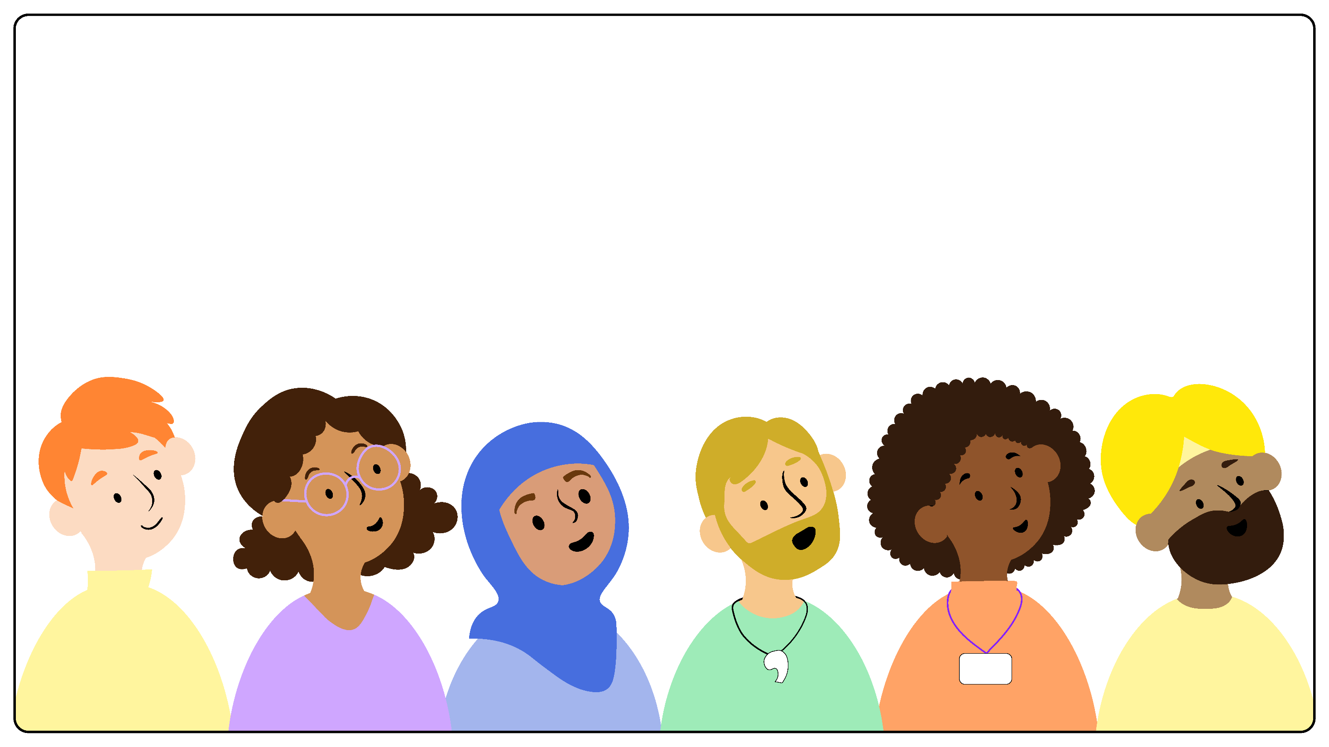





Who are the trusted adults you could talk to about things online or when using technology?
Auntie
and
Uncle
Parents or carers
Teacher and teaching assistant
Sports club leader
Grandparents
Notes:
Let’s remind ourselves, who are the trusted adults you could talk to about things online or when using technology?
[Take answers then display on screen]
Parents or carers
Grandparents
Aunties and Uncles
Sports club leader
Teachers and teaching assistants
It’s really important to tell a trusted adult if something happens that worries or upsets you.

Slide 15



Getting Help
Note to educators: Add names, words, or even photos to this slide to show learners who they can go to if they have an online safety concern
Notes:
Here at [name of school/setting], part of our job is making sure you feel safe and happy, in all parts of your life – including online!
If you ever have a worry about something that’s happened online, you can come to us for help and advice. We’ll always listen carefully and give you some ideas of what you can do. Sometimes, if we’re worried that you or somebody else might be in danger, we have to pass on what you’ve told us to a special member of staff. At [name of school/setting] that person is [name of staff member with safeguarding responsibility].
If we have to speak to them, it’s not because you’re in trouble, it’s just because they have the special job of making sure every child here is safe.
Note to educators – add names, words, or even photos to this slide to show learners who they can go to if they have an online safety concern.

Slide 16








I wonder what amazing things you might
use AI for in the future…
Notes:
This Safer Internet Day I want everyone to think carefully about how they choose to use technology, including AI. I hope you all make safe and responsible choices, and feel confident getting help if you need it.
I know that everyone here has the potential to do amazing things – using your words and actions, using your brains and your imagination, and maybe… using technology too!
I wonder what amazing things you might use AI for in the future…

Slide 17
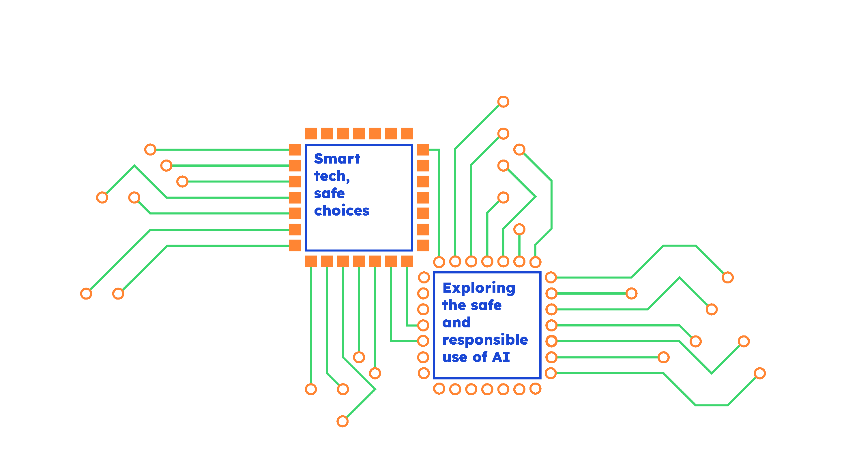

Notes:
Happy Safer Internet Day everyone!

